Slide 1
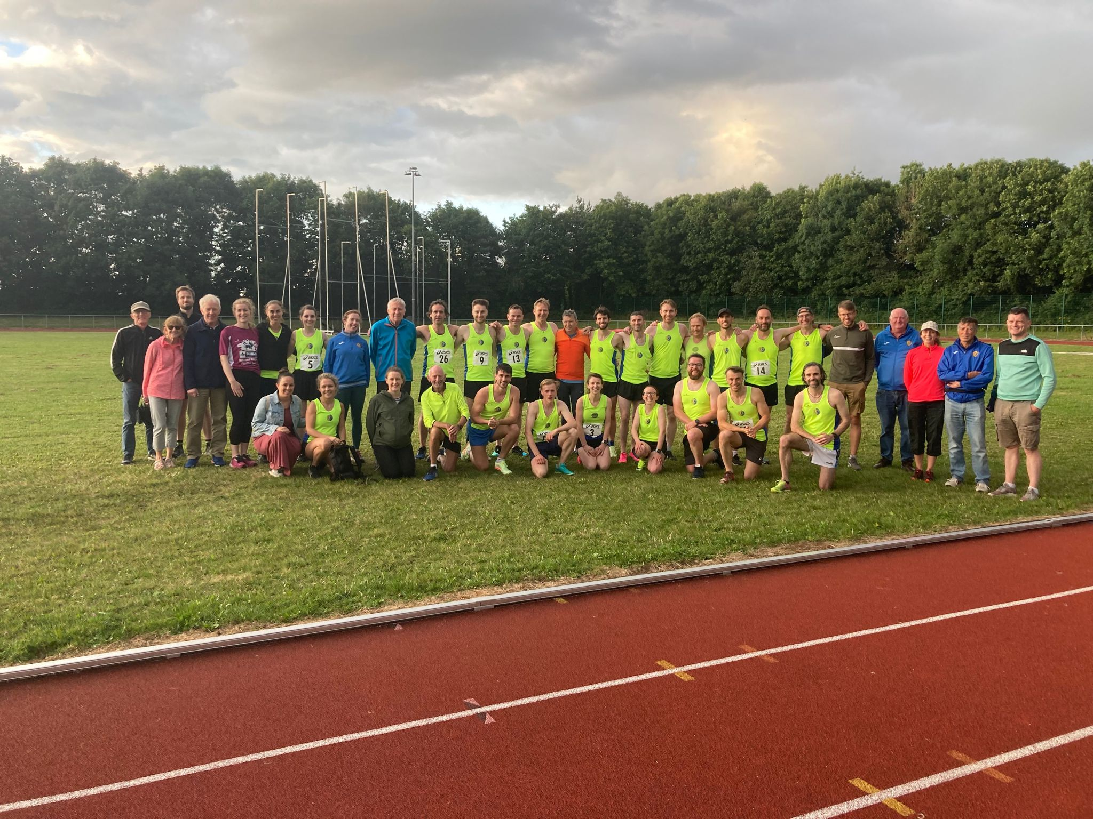

Records Secretary Report
2022/2023 Season

Slide 2
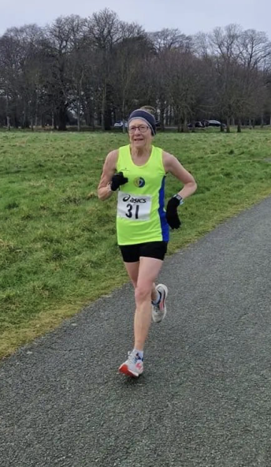
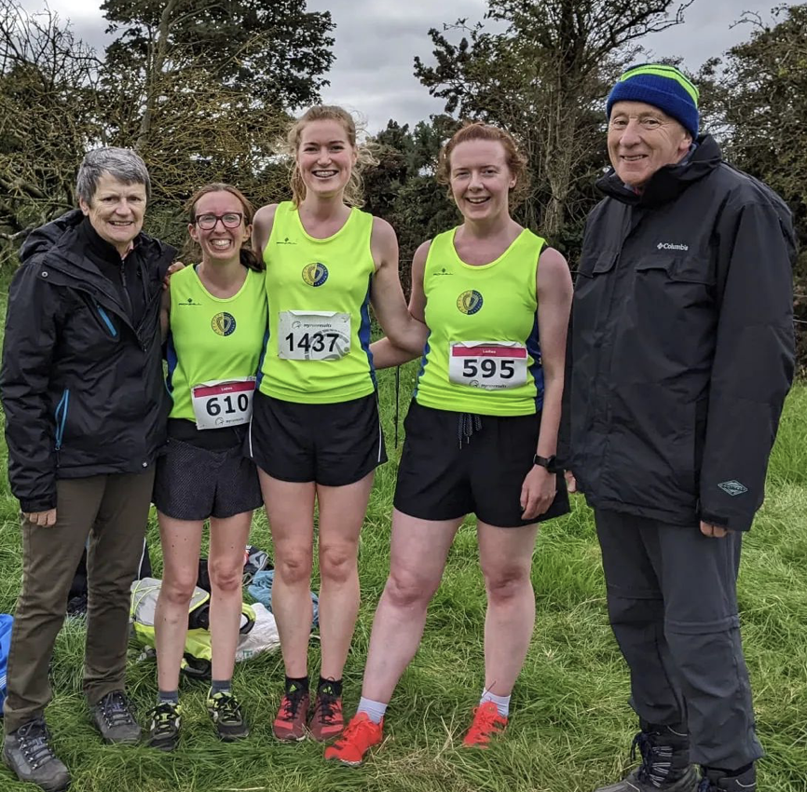
Content
Cross Country Season
Track Season
Road Races
LVAC Championships & Trophies
2

Slide 3
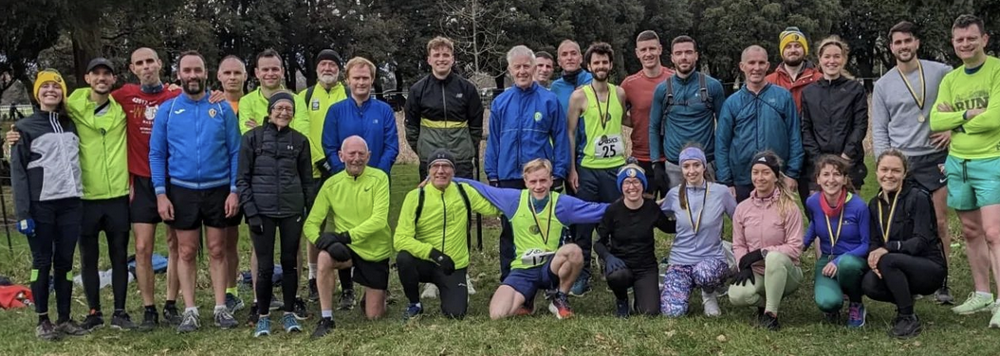
ROAD RACES
Cross country review
2022/2023 Season Review
Notes:
ID=dd91c577-f997-49fe-a5eb-611d59b20eb8 Recipe=crop Type=Foreground Variant=0 FamilyID=ClassicFrameGoudy_Zero

Slide 4
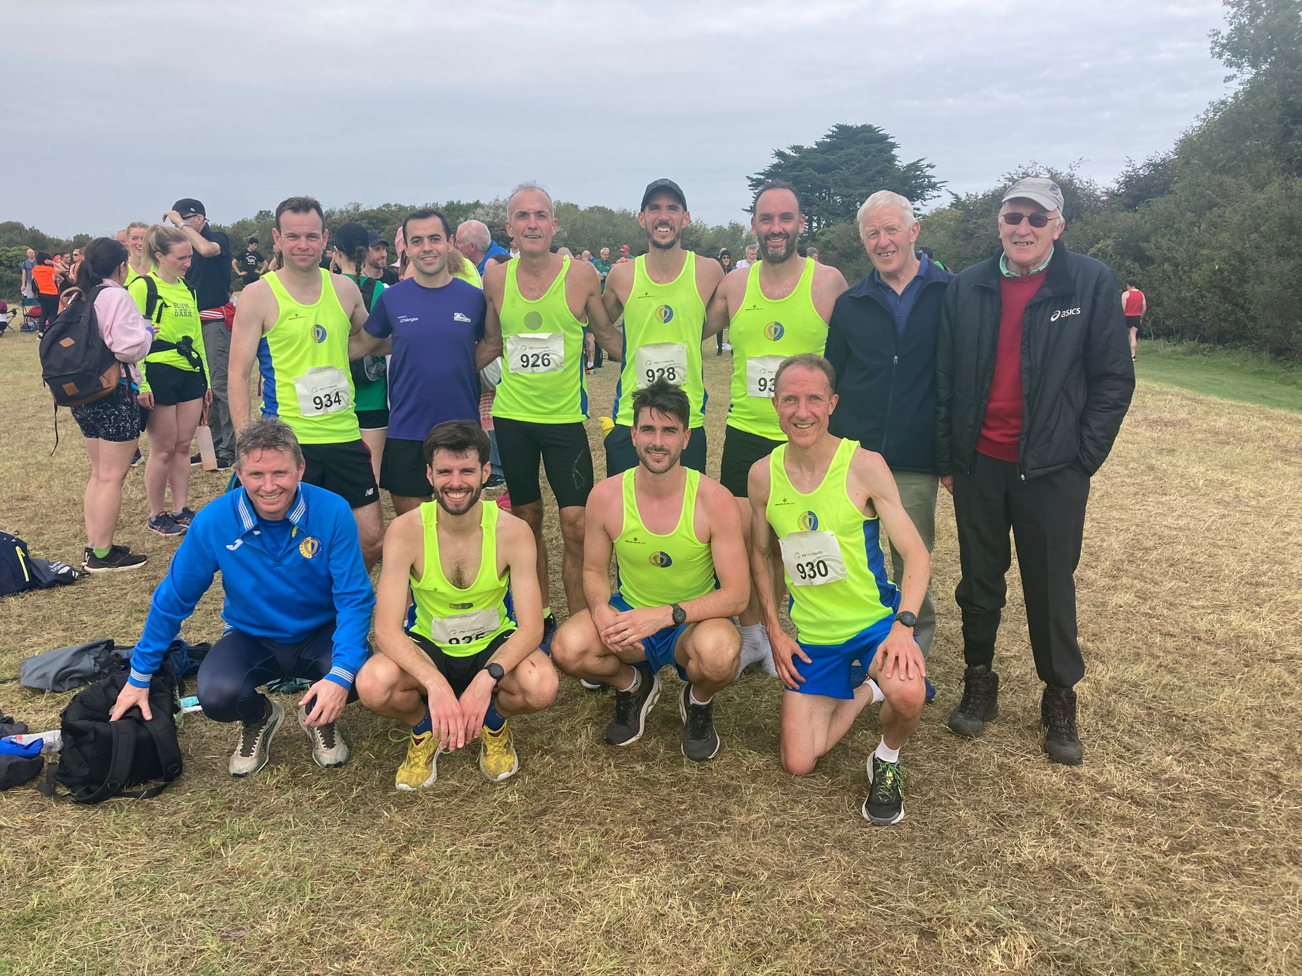
CROSS COUNTRY summary
38 Athletes took part across 10 championship races
111 athletes entered
Women 36
Men 40
Masters 35
Team Medals 🥈🥈
Individual Medals 🥇🥈🥉🥇🥇🥇🥈🥉🥇🥉🥉🥉
10+ Tents Assembled 🙏👏 🙏👏 🙏👏 🙏👏 🙏👏

Slide 5
CROSS COUNTRY races
October
Dublin Novice
AAI Autumn Open
November
Dublin Senior
December
Dublin Inter
National Novice
LVAC Cake Race
Dublin Masters
Leinster Inter
Leinster Masters
LVAC 5k XC
January
February
National Inter
National Masters
LVAC XC Championship
Leinster Novice

Slide 6
Cross country participation
2022/2023 Season Review
Notes:
ID=dd91c577-f997-49fe-a5eb-611d59b20eb8 Recipe=crop Type=Foreground Variant=0 FamilyID=ClassicFrameGoudy_Zero

Slide 7
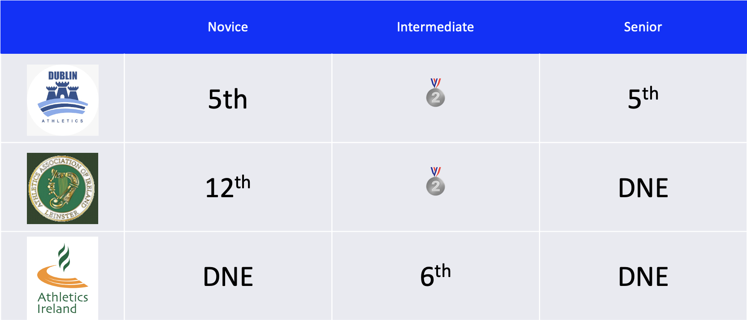



WOMEN TEAM POSITIONS
 | Novice | Intermediate | Senior
 | 5th | 🥈 | 5th
 | 12th | 🥈 | DNE
 | DNE | 6th | DNE
2022/2023 Season Review

Slide 8
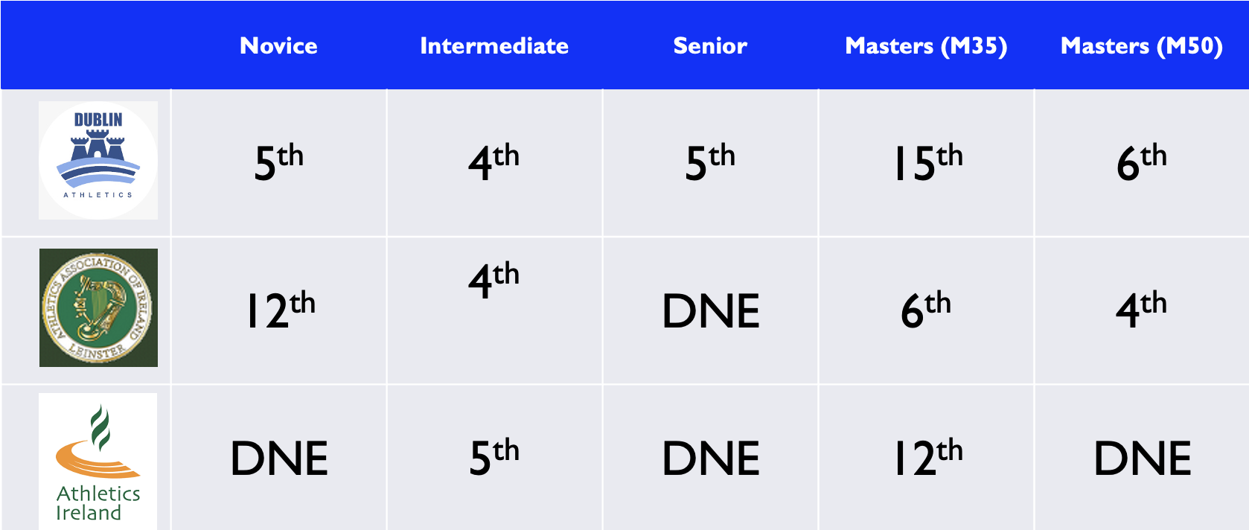
Men TEAM POSITIONS
 | Novice | Intermediate | Senior | Masters (M35) | Masters (M50)
 | 5th | 4th | 5th | 15th | 6th
 | 12th | 4th | DNE | 6th | 4th
 | DNE | 5th | DNE | 12th | DNE

Slide 9

Individual Master MEDALS
🥇Tom O’Connor M60 🥈Una Reilly F70 🥉Arnaud Benjacar M50 | 🥇Peter Arthur M35 🥈Tom O’Connor M60 🥉Pat Collins M70 🥇Peter Arthur M35 County 🥇Arnaud Benjacar M50 County | 🥇Pat Collins M75 🥉Una Reilly F70 🥉Peter Arthur M35 | 🥈Tom O’Connor M60 (Team)
2022/2023 Season Review

Slide 10
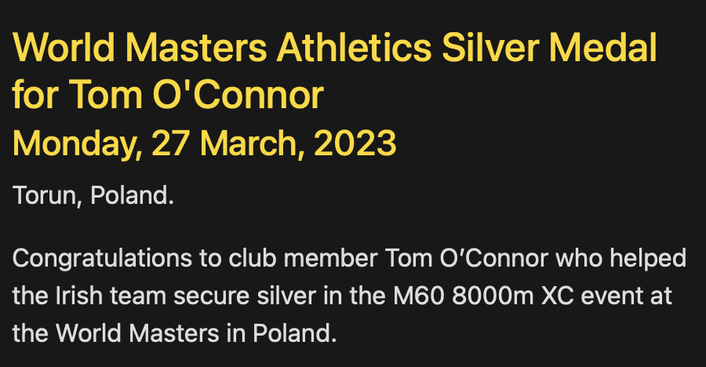
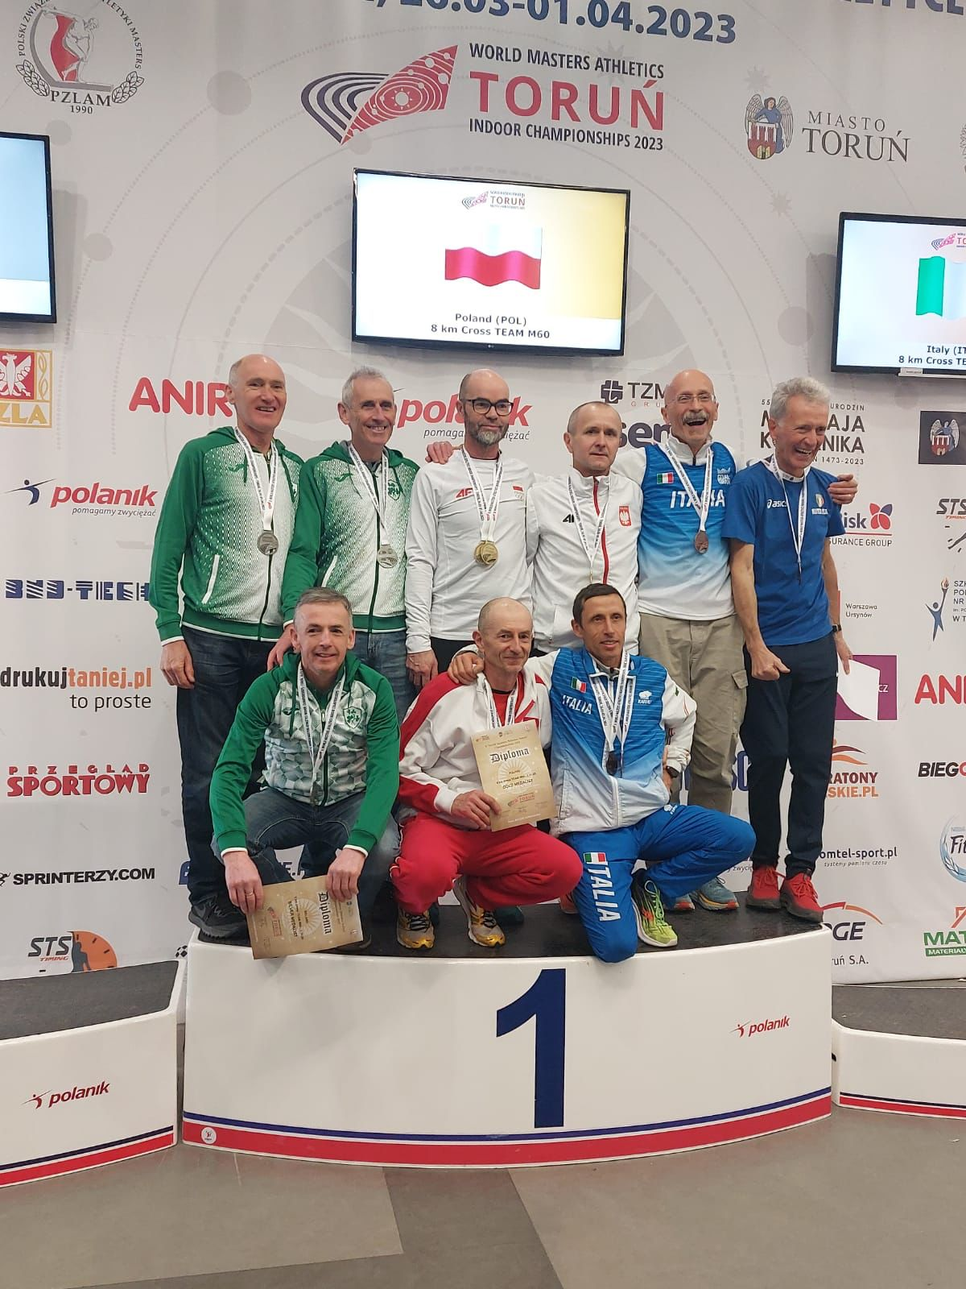
2022/2023 Season Review

Slide 11
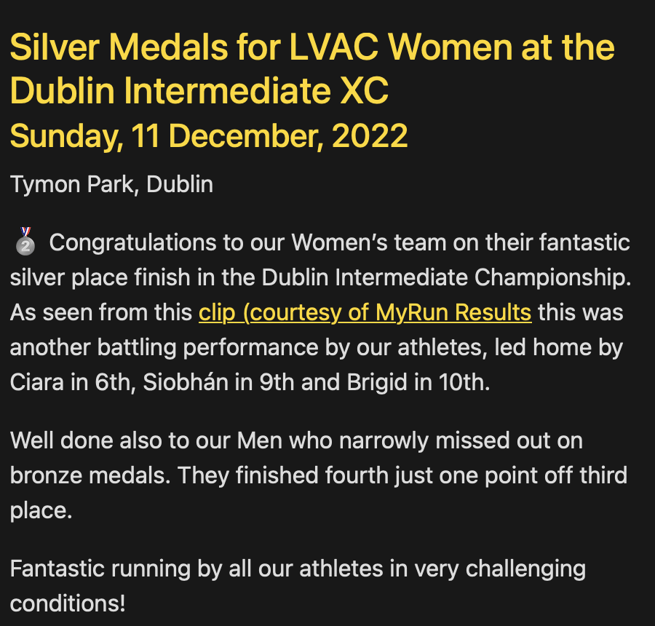
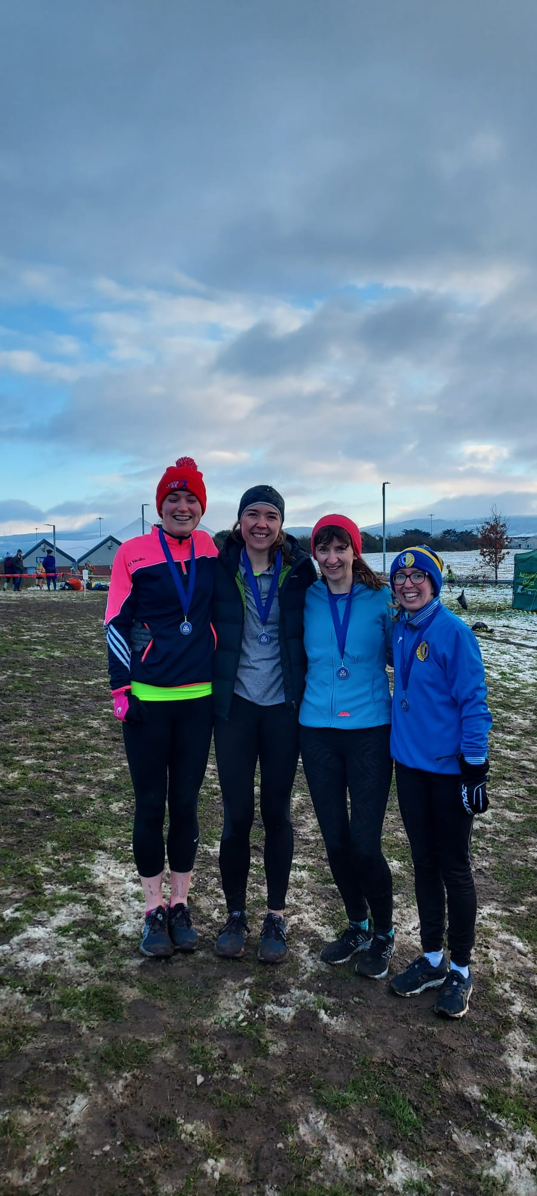
2022/2023 Season Review

Slide 12
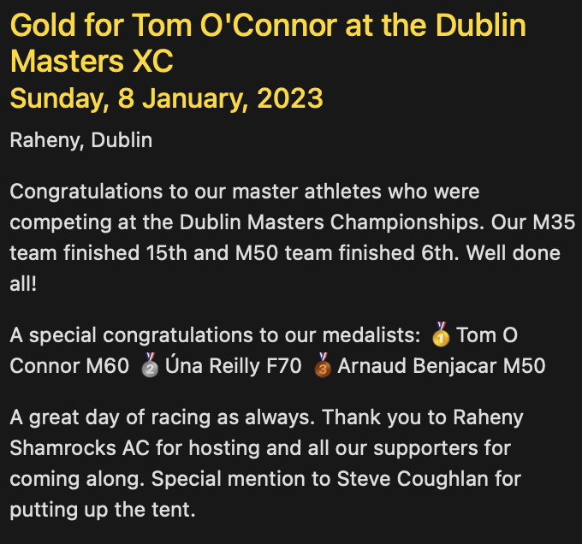
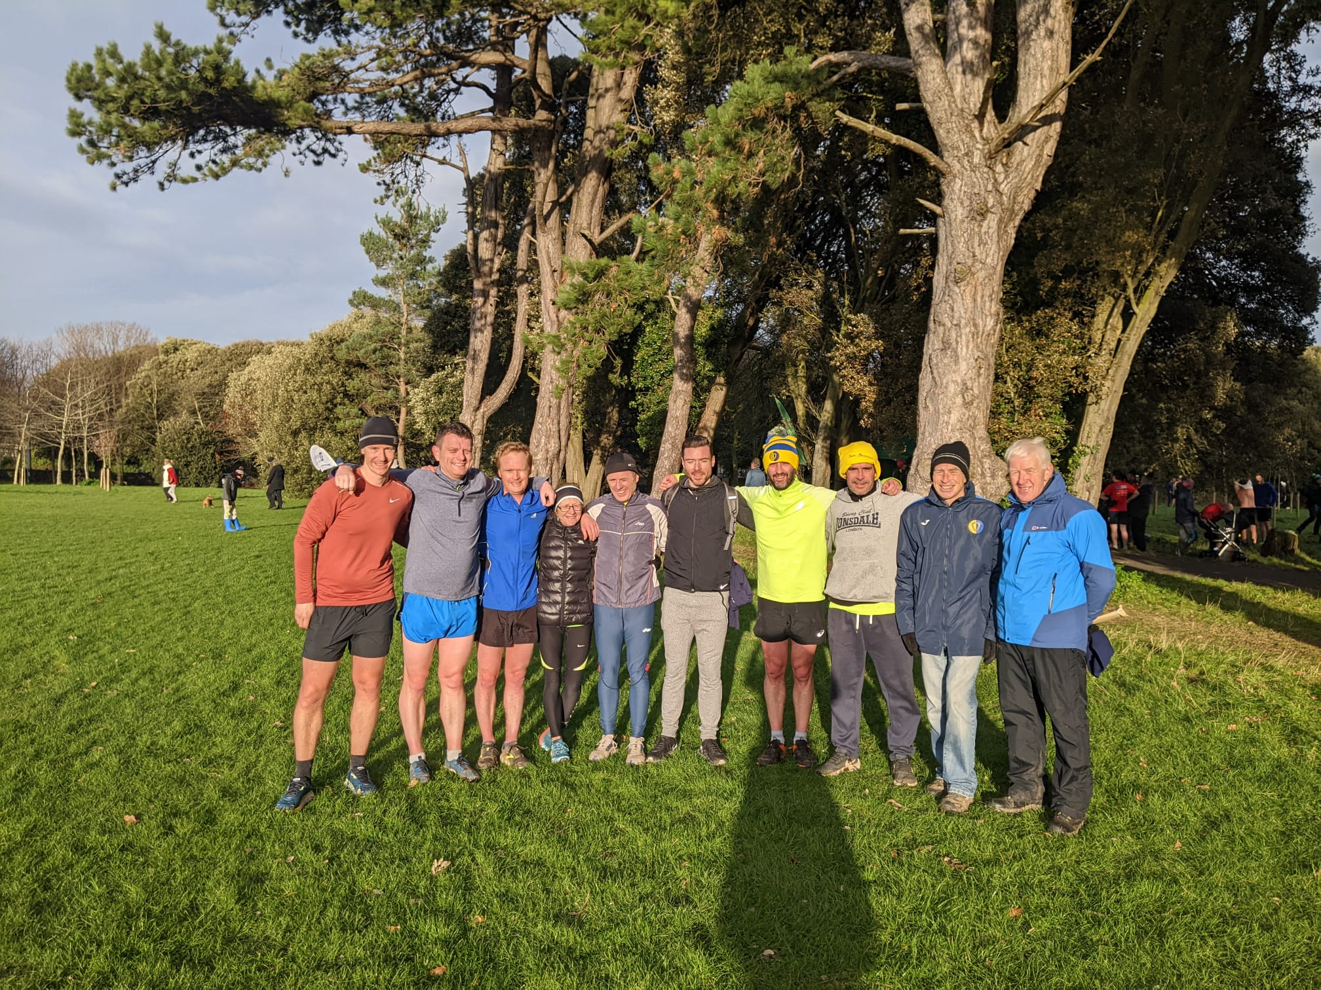
2022/2023 Season Review

Slide 13
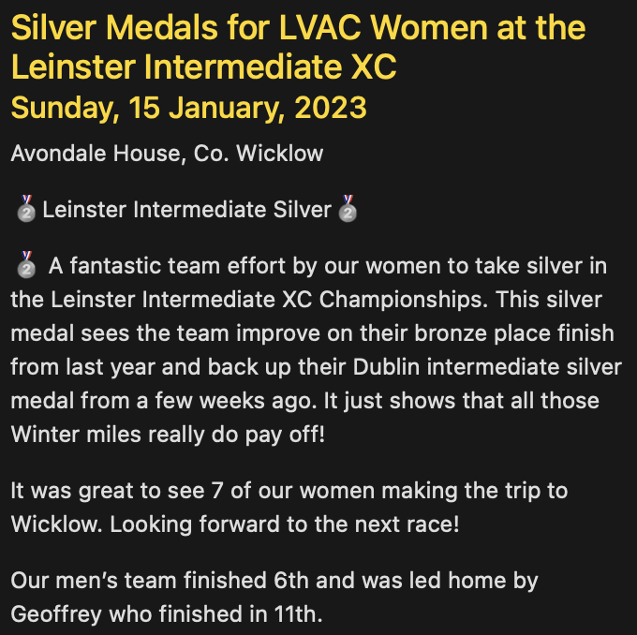
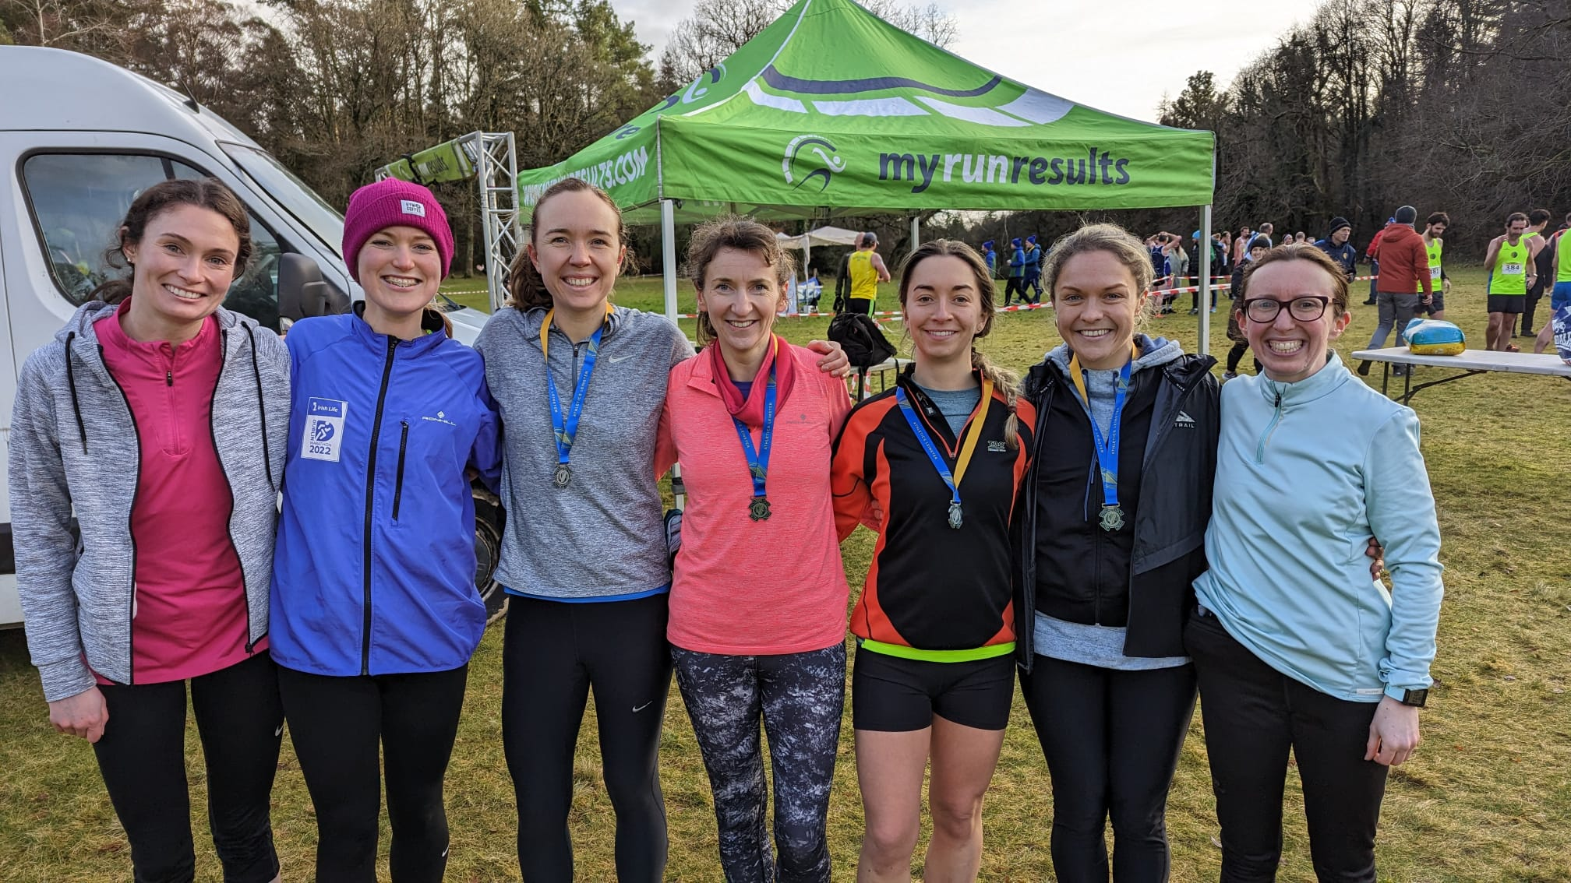
2022/2023 Season Review

Slide 14
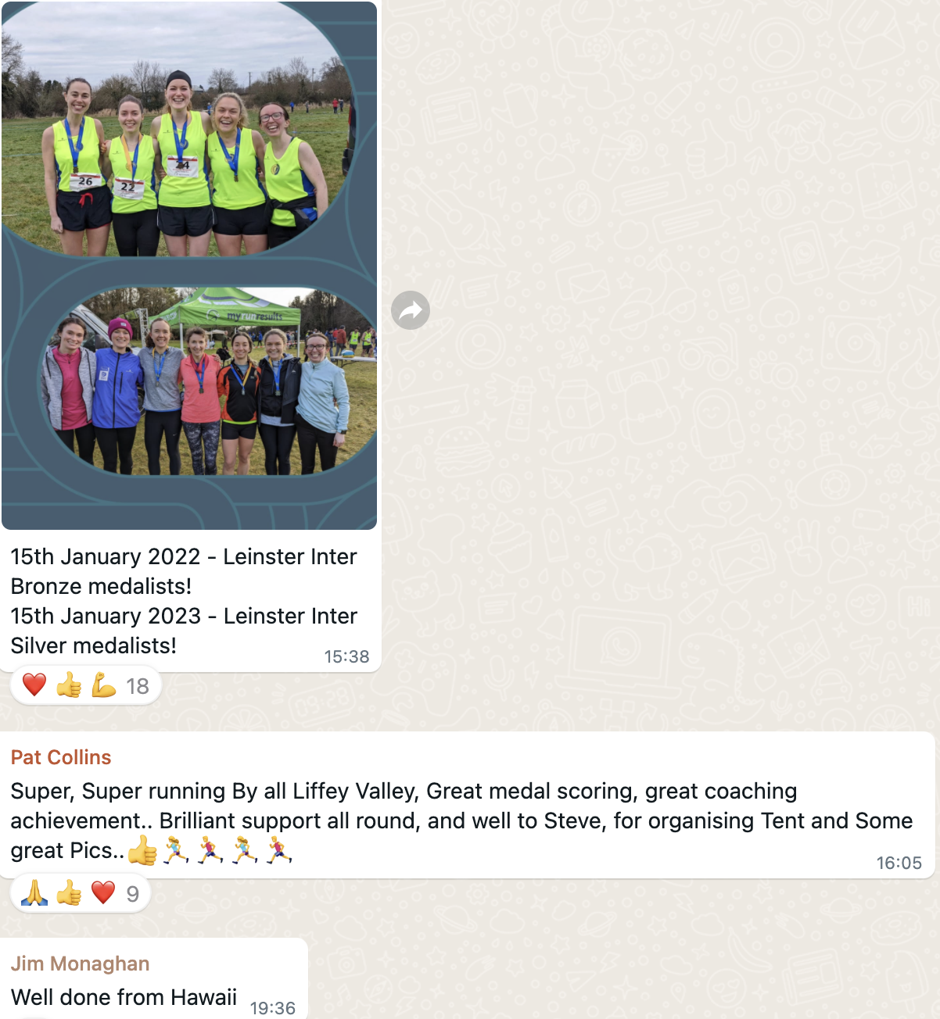
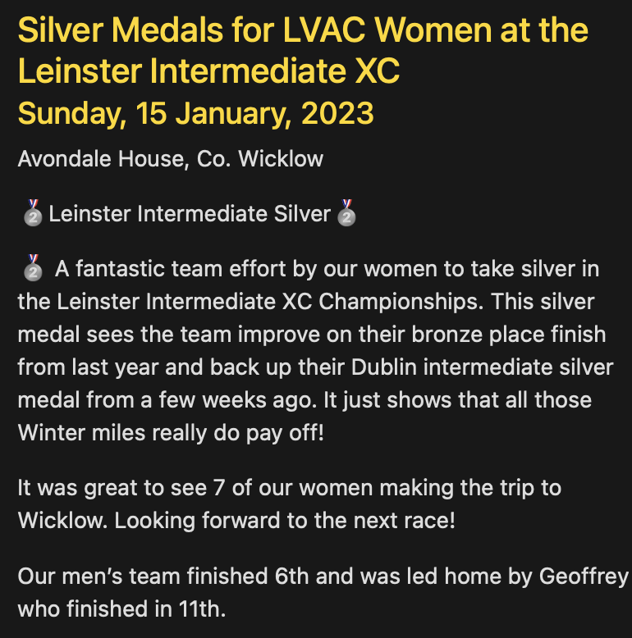
2022/2023 Season Review

Slide 15
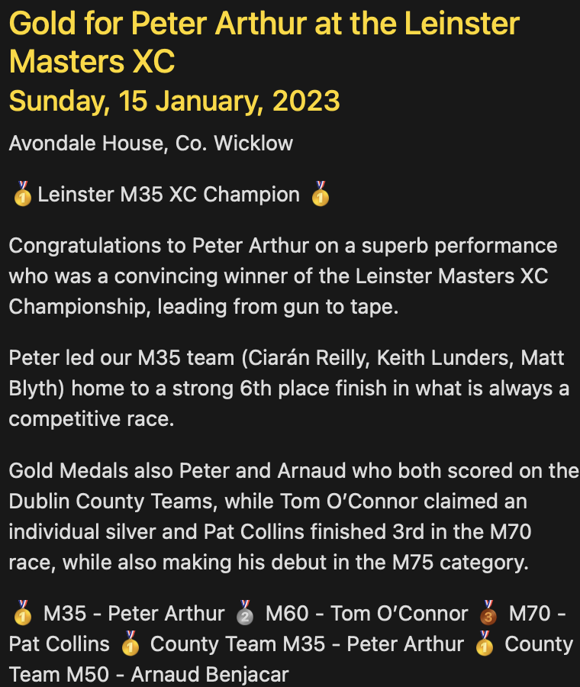
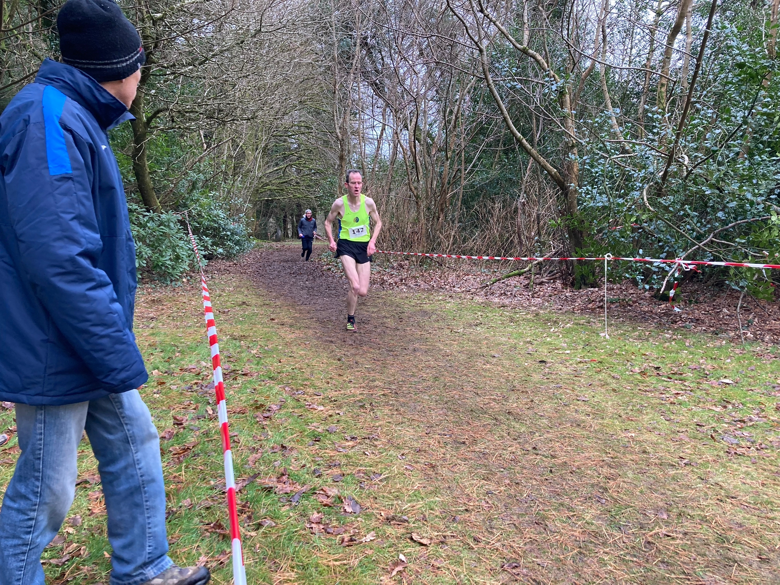
2022/2023 Season Review

Slide 16
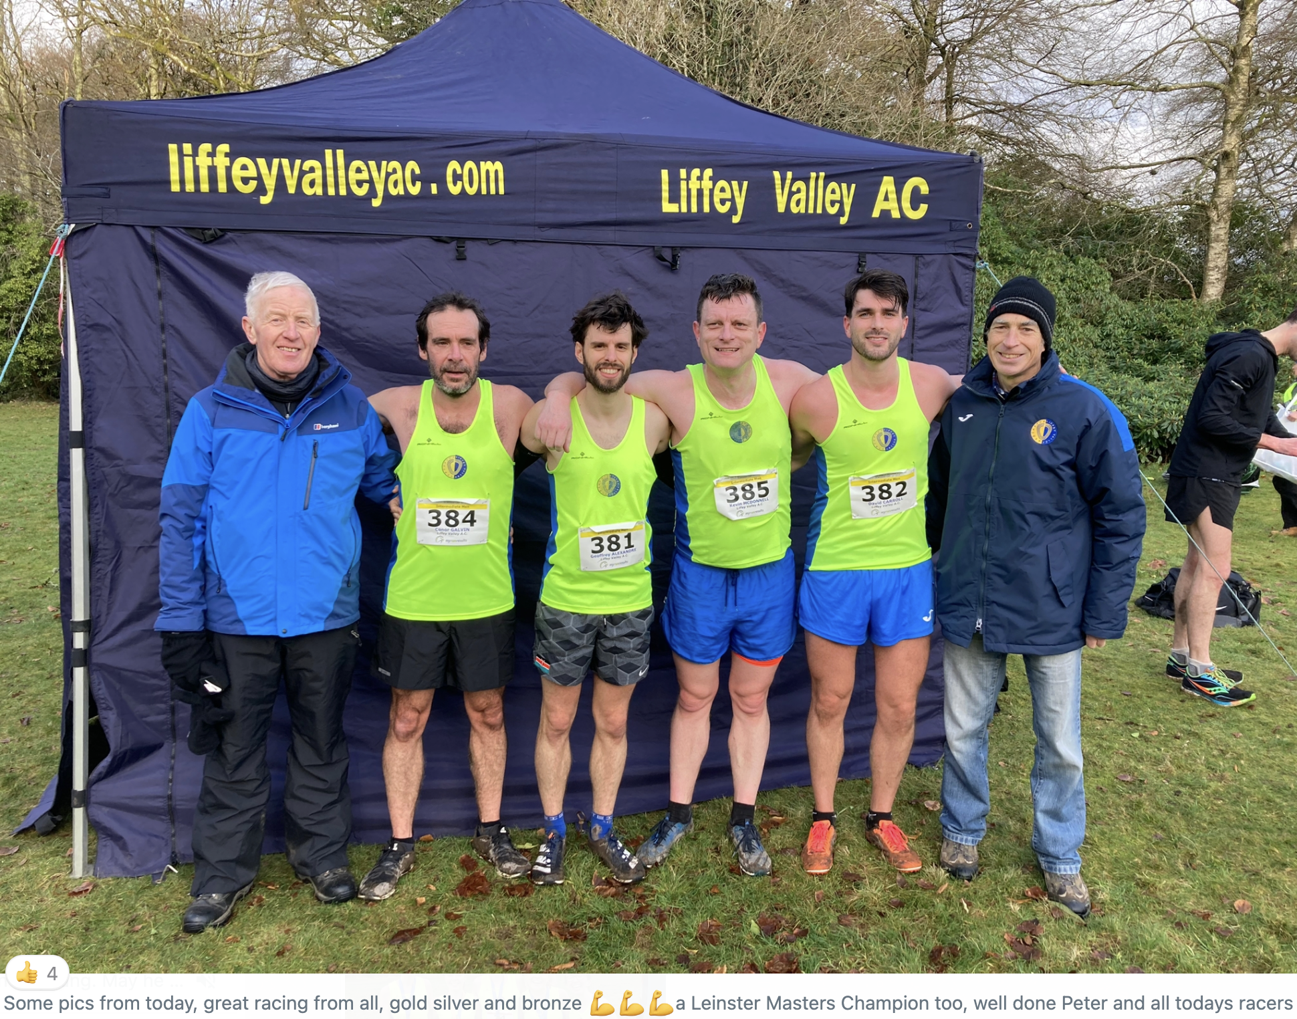
2022/2023 Season Review

Slide 17
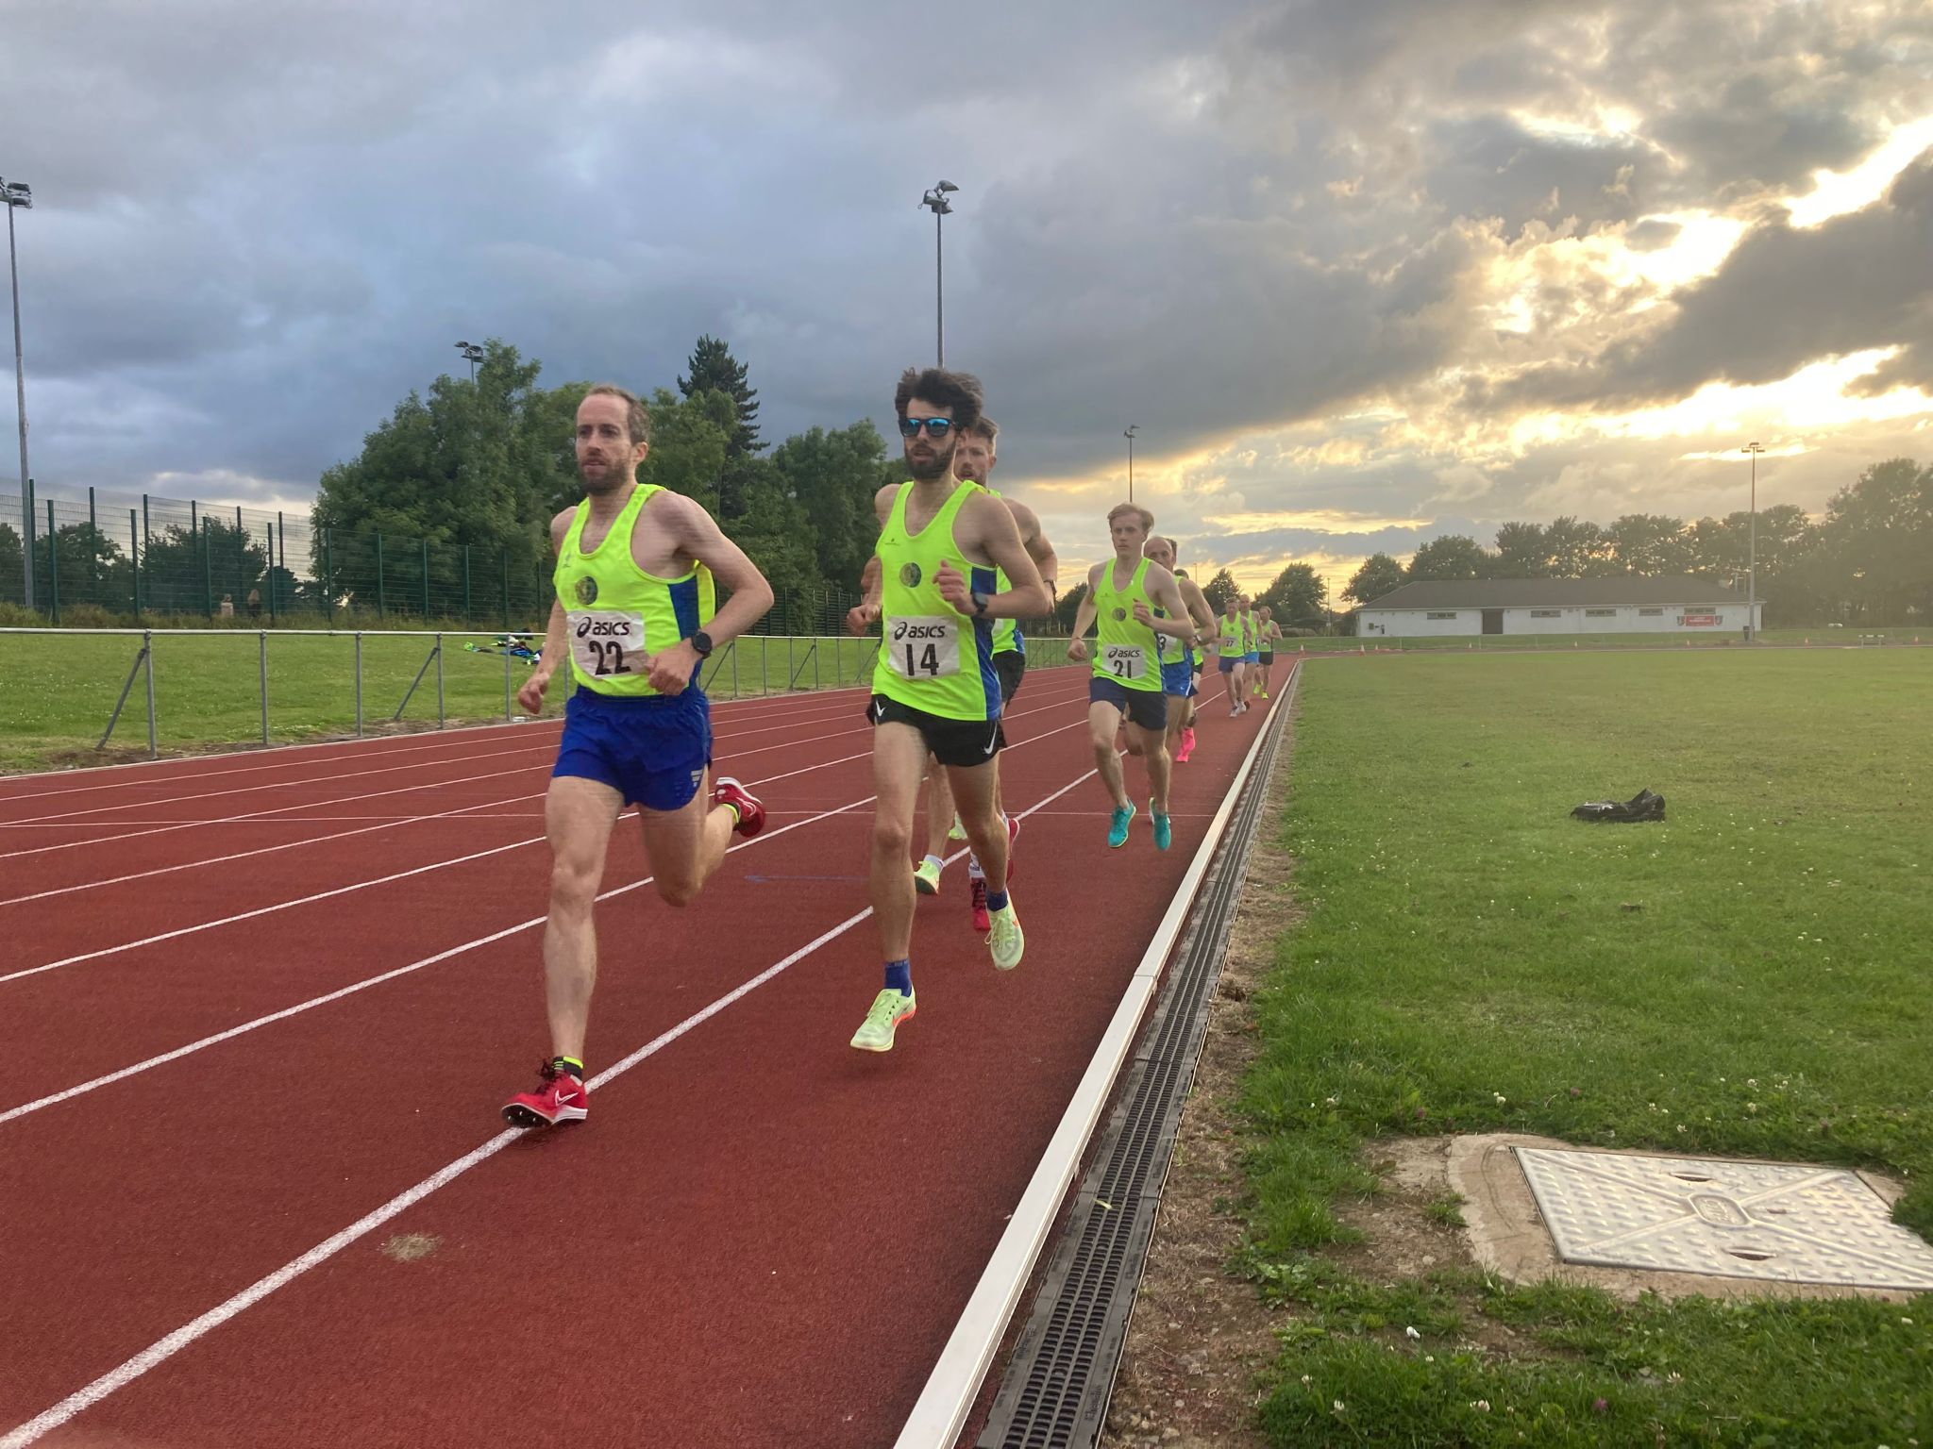
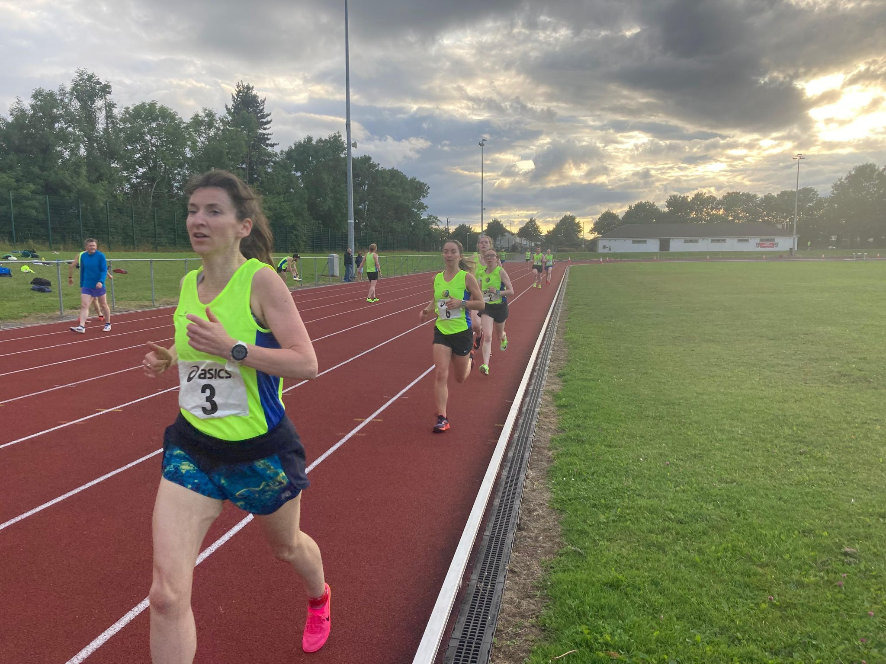
ROAD RACES
Track review
2022/2023 Season Review
Notes:
ID=dd91c577-f997-49fe-a5eb-611d59b20eb8 Recipe=crop Type=Foreground Variant=0 FamilyID=ClassicFrameGoudy_Zero

Slide 18
track RACES
April
29th Dublin Graded 1
May
10th Dublin Graded 2
24th Dublin Graded 3
29th Leinster Track & Field Championships
June
3rd Dublin Graded 4
21st Dublin Graded 5
28th LVAC 800m
5th Dublin Graded 6
12th LVAC 1500m
12th LVAC 3000m
19th Dublin Graded 7
30th National Senior
July
August
2nd Dublin Graded 8
February
5th National Indoor Masters

Slide 19
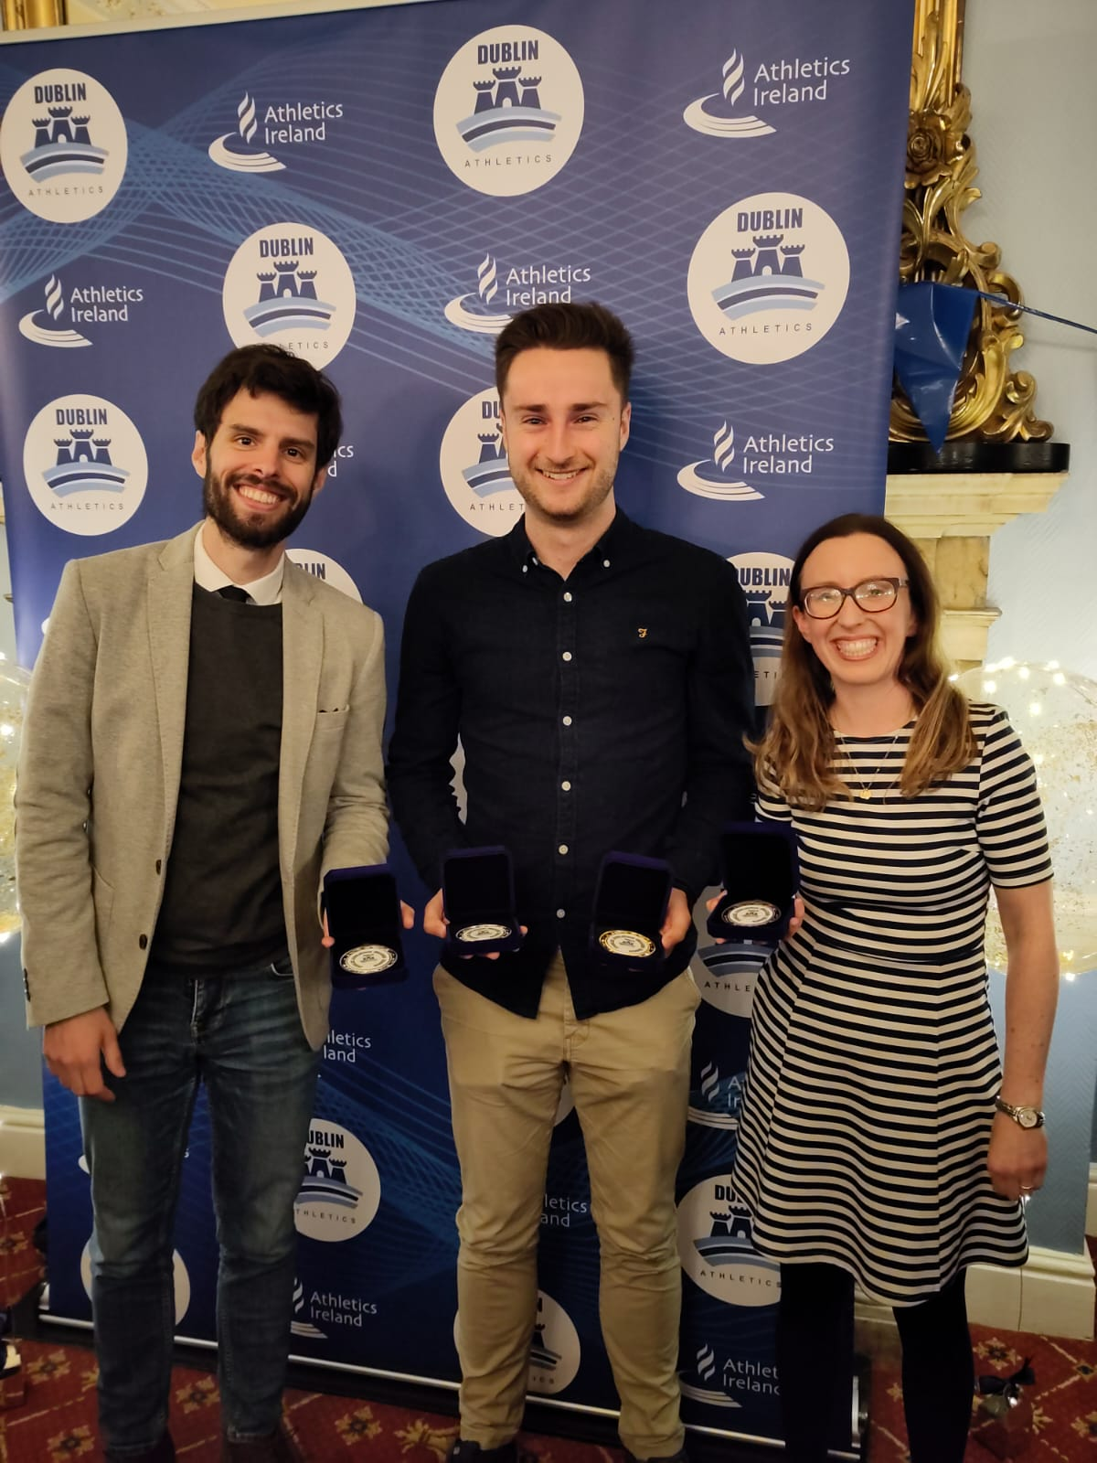
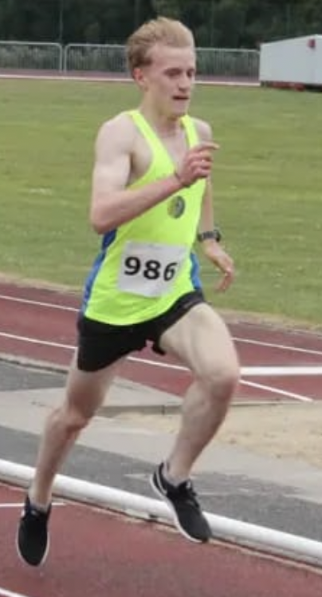
DUBLIN GRADED track SUMMARY
Participation across 8 meets
Women 6
Men 20
Top 3 Finishes from 88 starts
1st 6
2nd 9
3rd 14
Top 3 Grand Prix Grade Winners:
Geoffrey 🥈 Grade B
Sergei 🥇 Grade C
Conor 🥈 Grade C
Orla 🥉 Grade C

Slide 20
Dublin graded races
2022/2023 Season Review
Notes:
ID=dd91c577-f997-49fe-a5eb-611d59b20eb8 Recipe=crop Type=Foreground Variant=0 FamilyID=ClassicFrameGoudy_Zero

Slide 21
Dublin graded APPEARANCES
2022/2023 Season Review
Notes:
ID=dd91c577-f997-49fe-a5eb-611d59b20eb8 Recipe=crop Type=Foreground Variant=0 FamilyID=ClassicFrameGoudy_Zero

Slide 22
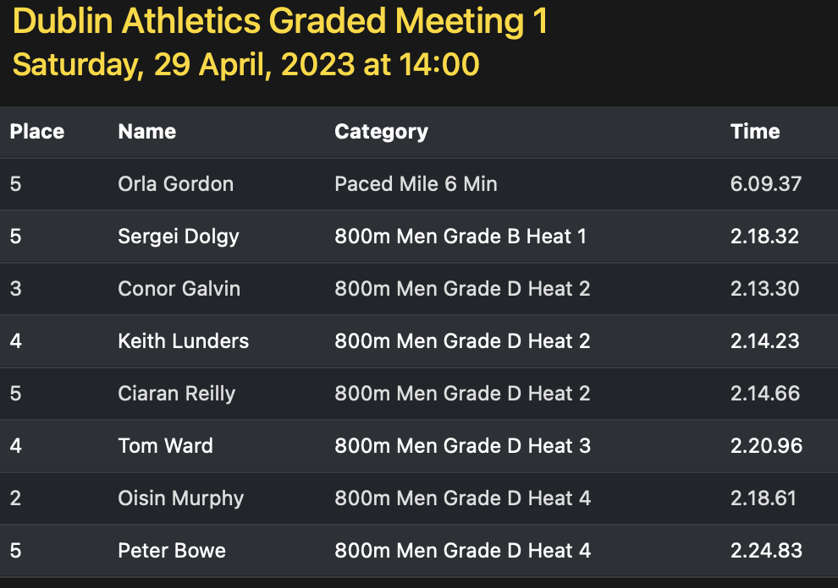
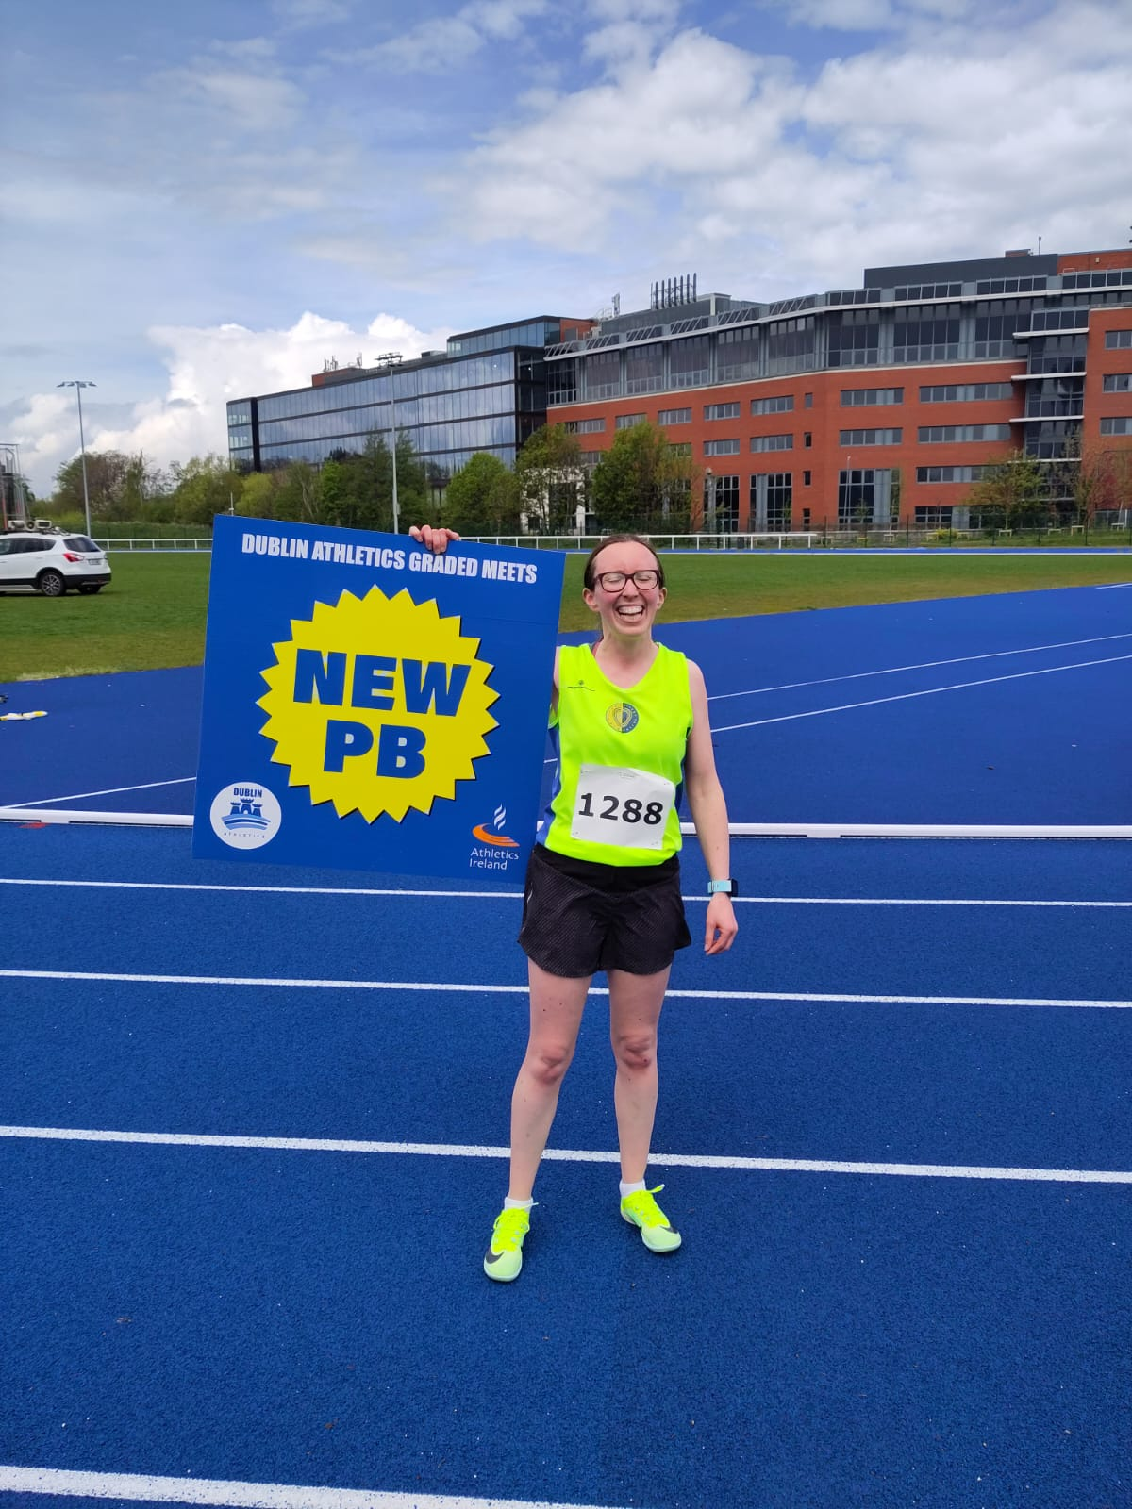
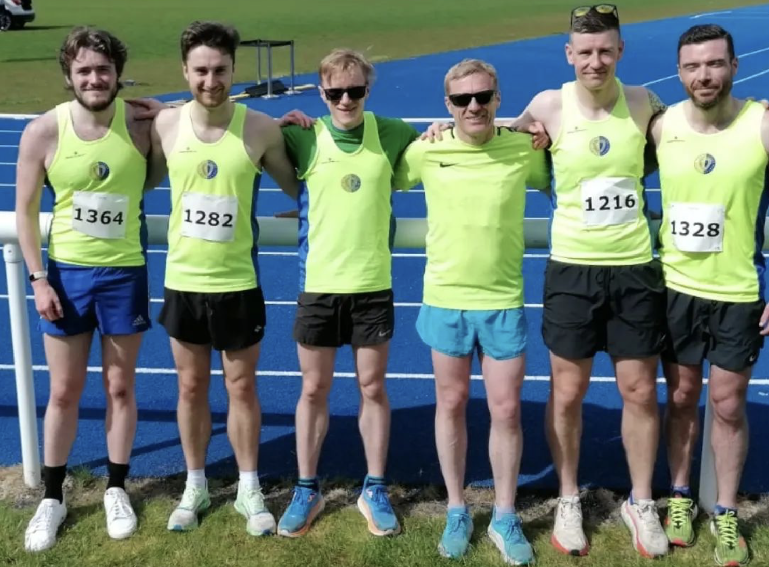
ROAD RACES
2022/2023 Season Review
Notes:
ID=dd91c577-f997-49fe-a5eb-611d59b20eb8 Recipe=crop Type=Foreground Variant=0 FamilyID=ClassicFrameGoudy_Zero

Slide 23
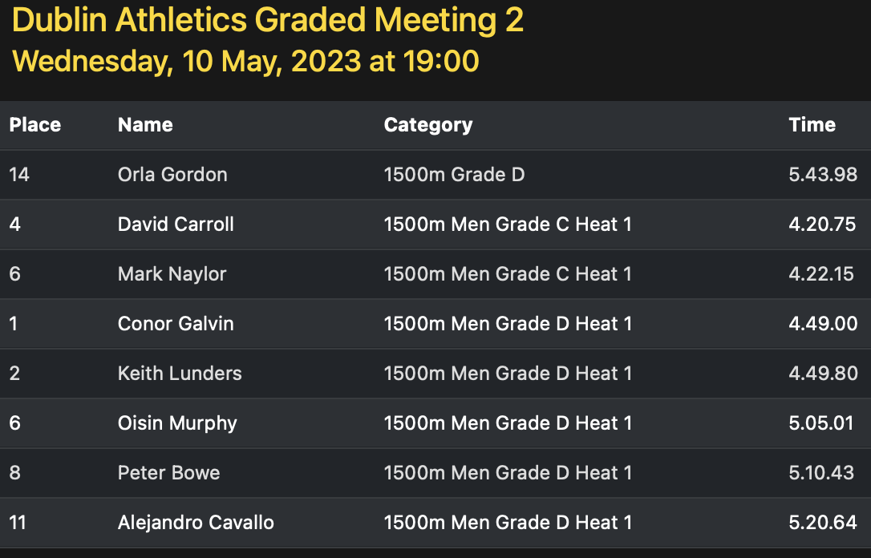
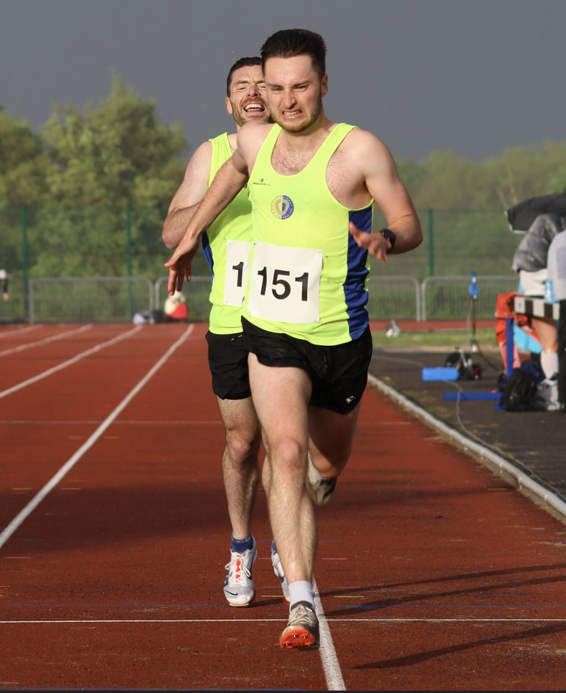
ROAD RACES
2022/2023 Season Review
Notes:
ID=dd91c577-f997-49fe-a5eb-611d59b20eb8 Recipe=crop Type=Foreground Variant=0 FamilyID=ClassicFrameGoudy_Zero

Slide 24
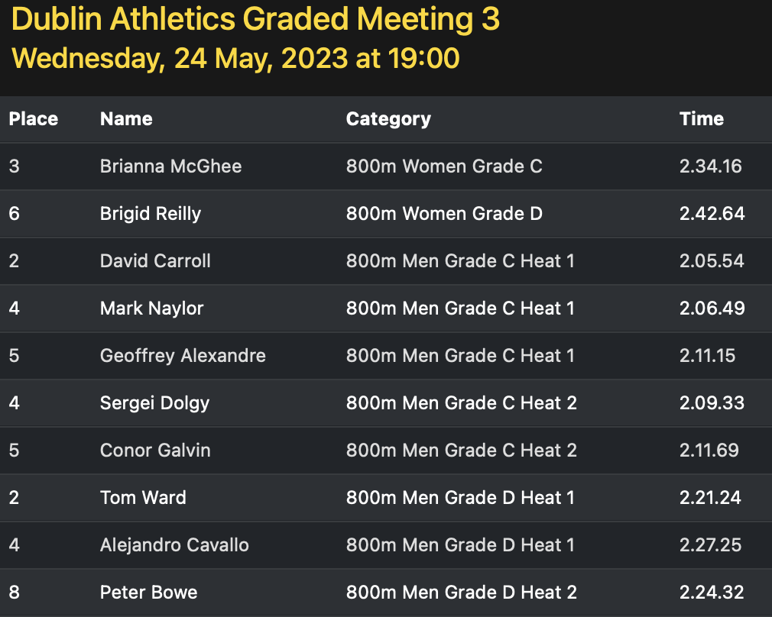
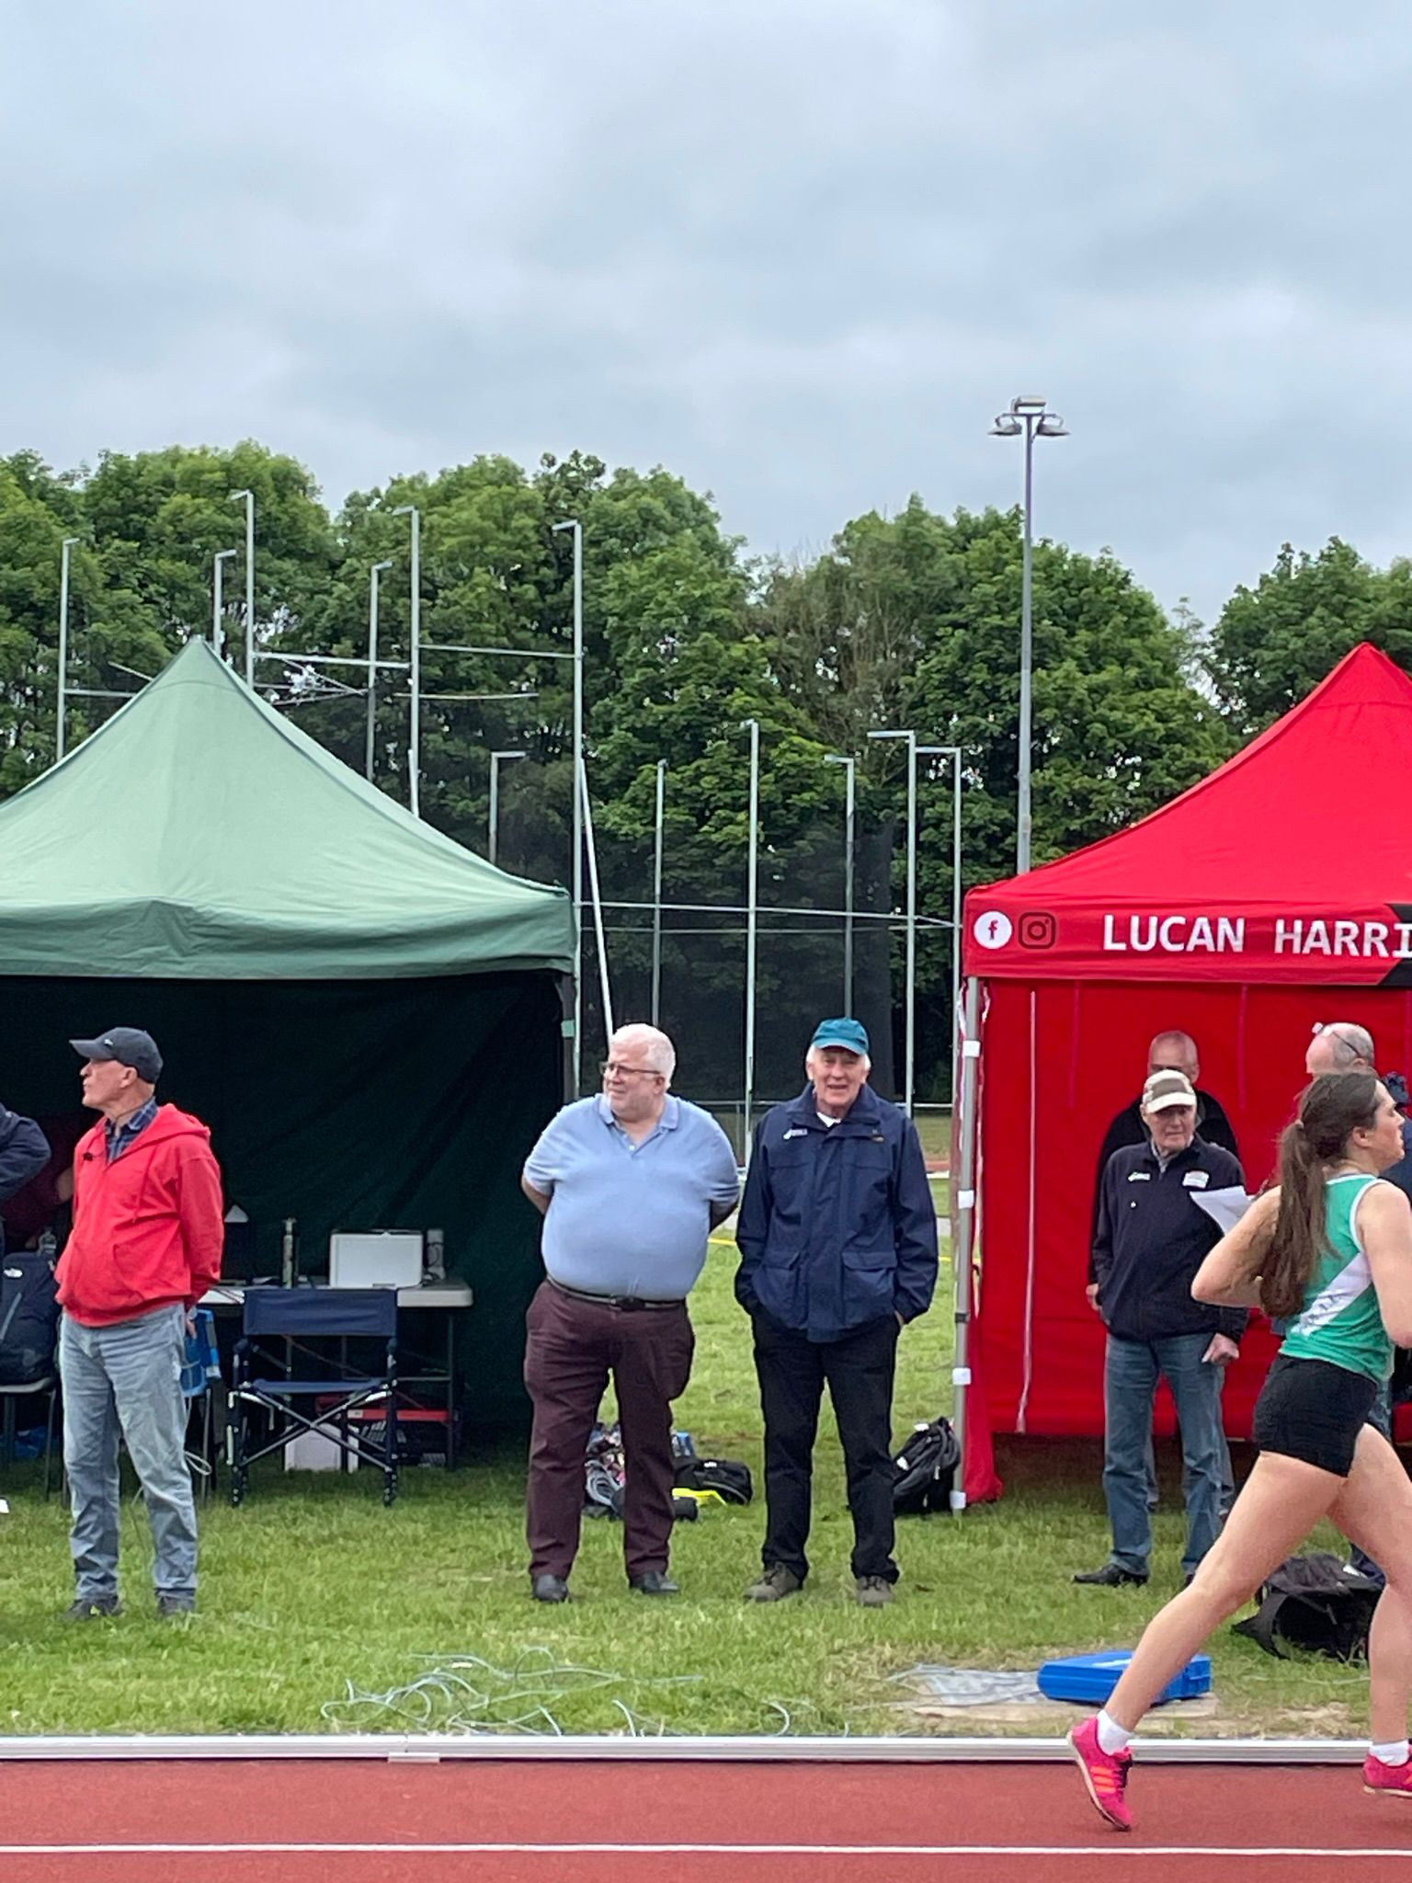
ROAD RACES
2022/2023 Season Review
Notes:
ID=dd91c577-f997-49fe-a5eb-611d59b20eb8 Recipe=crop Type=Foreground Variant=0 FamilyID=ClassicFrameGoudy_Zero

Slide 25
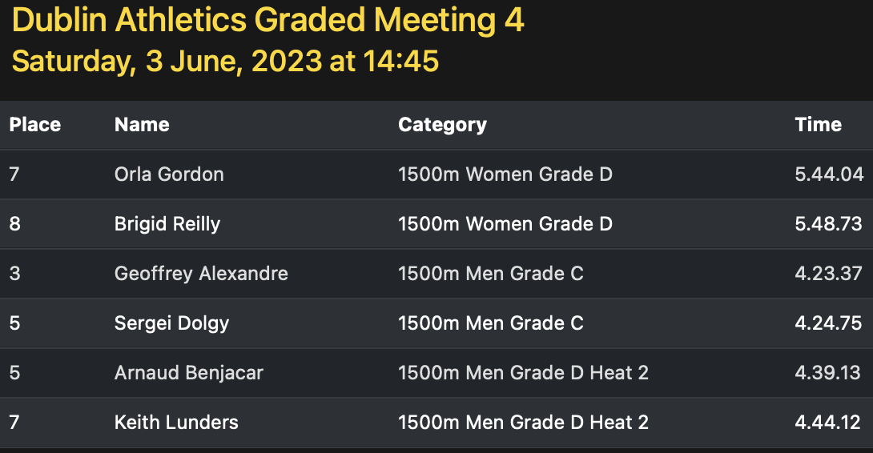
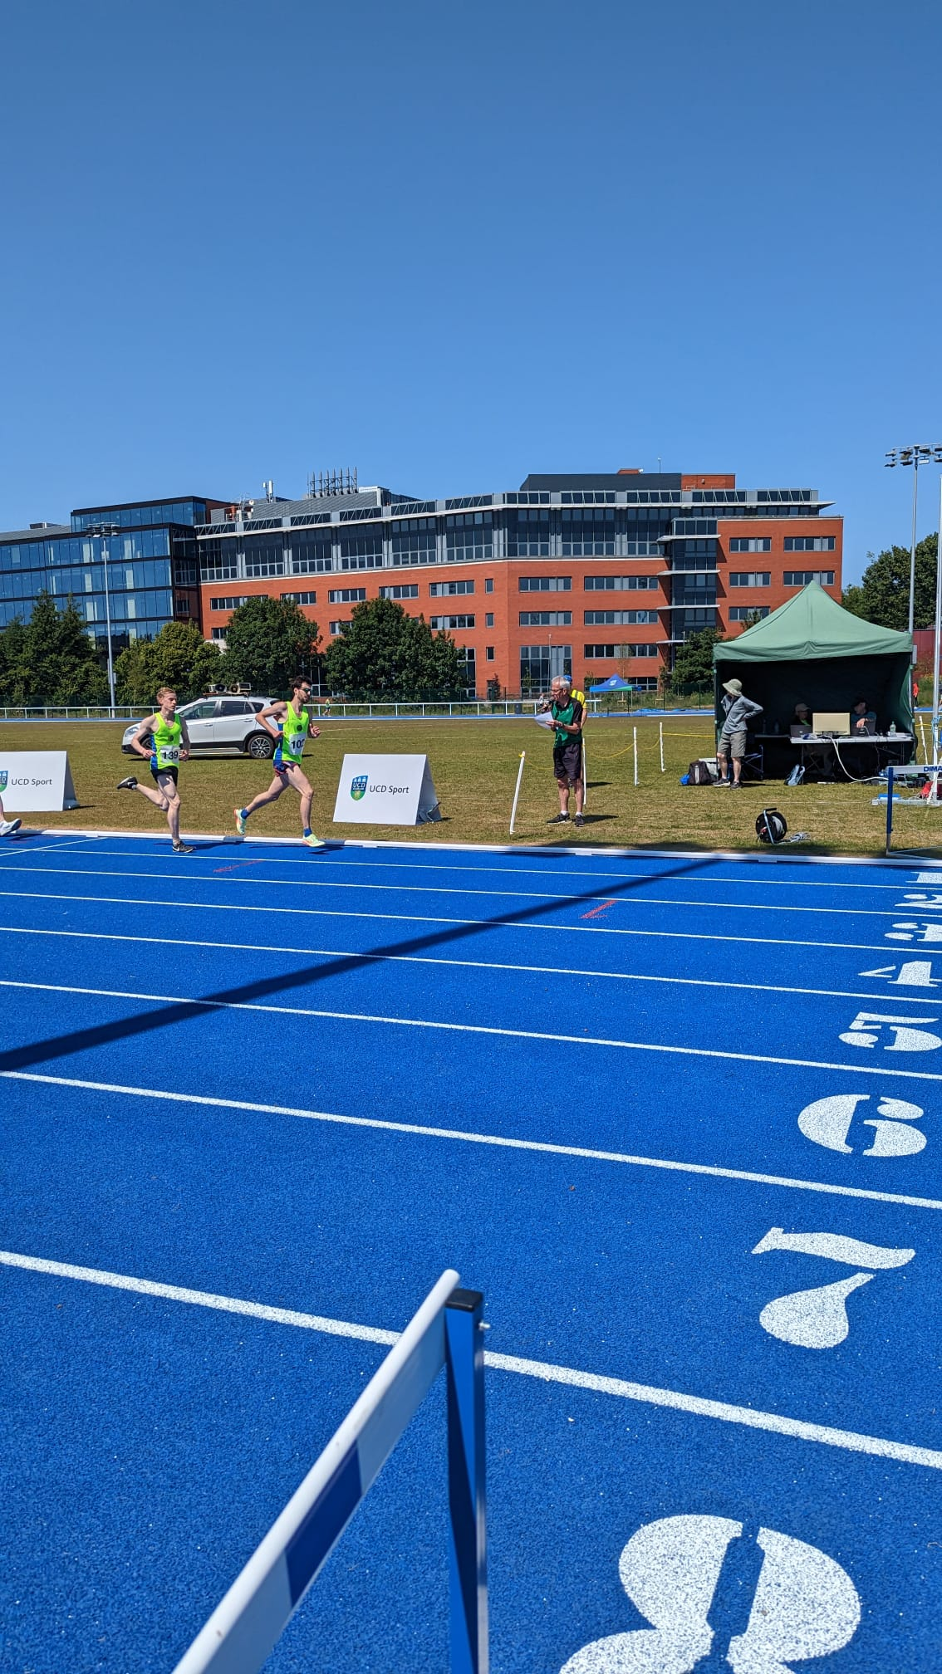
ROAD RACES
2022/2023 Season Review
Notes:
ID=dd91c577-f997-49fe-a5eb-611d59b20eb8 Recipe=crop Type=Foreground Variant=0 FamilyID=ClassicFrameGoudy_Zero

Slide 26
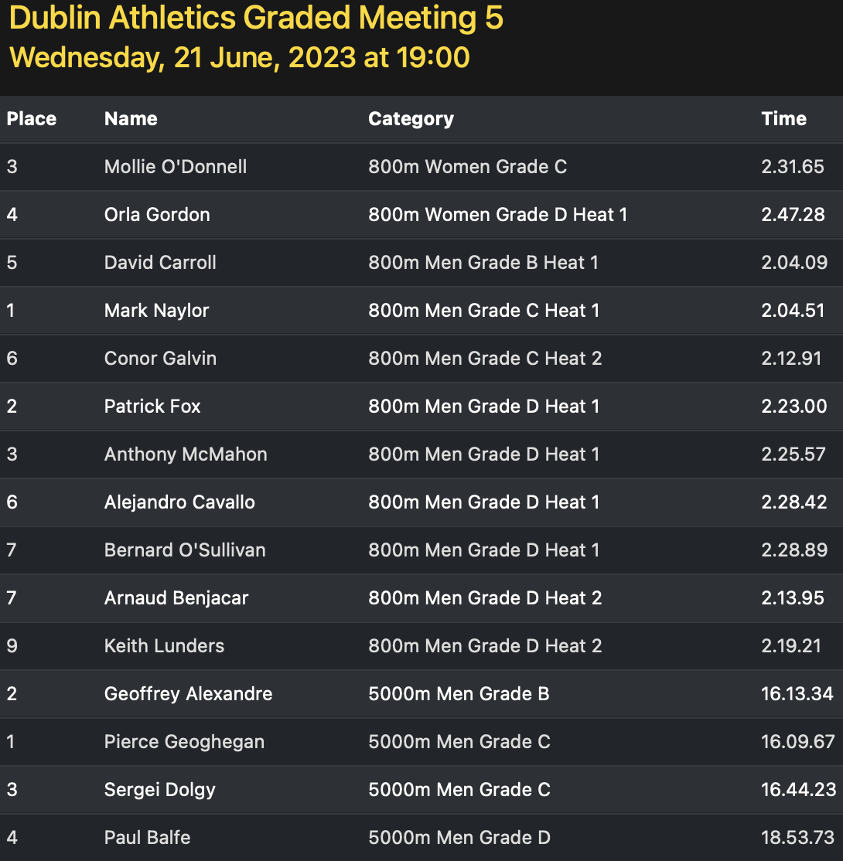
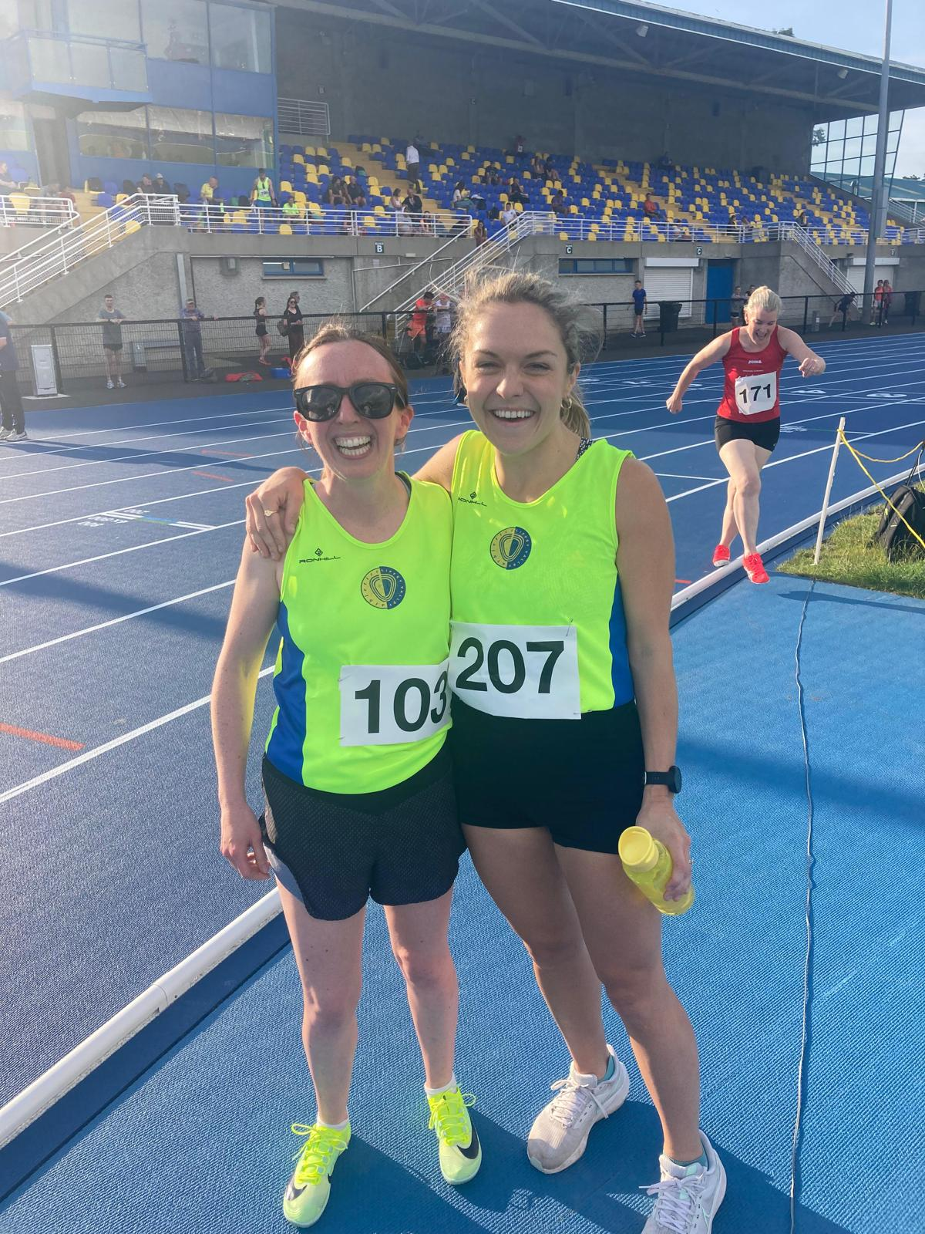
ROAD RACES
2022/2023 Season Review
Notes:
ID=dd91c577-f997-49fe-a5eb-611d59b20eb8 Recipe=crop Type=Foreground Variant=0 FamilyID=ClassicFrameGoudy_Zero

Slide 27
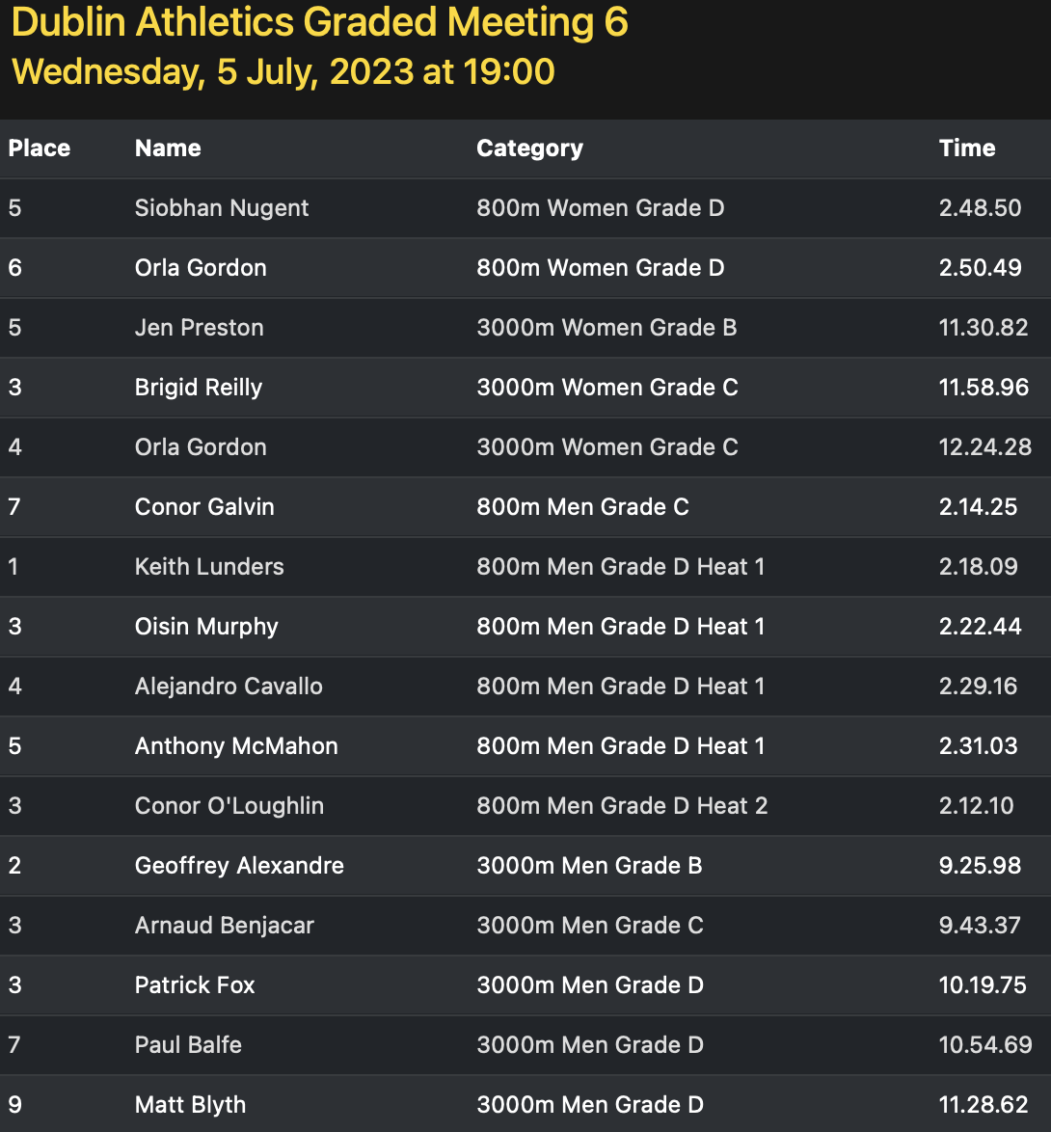
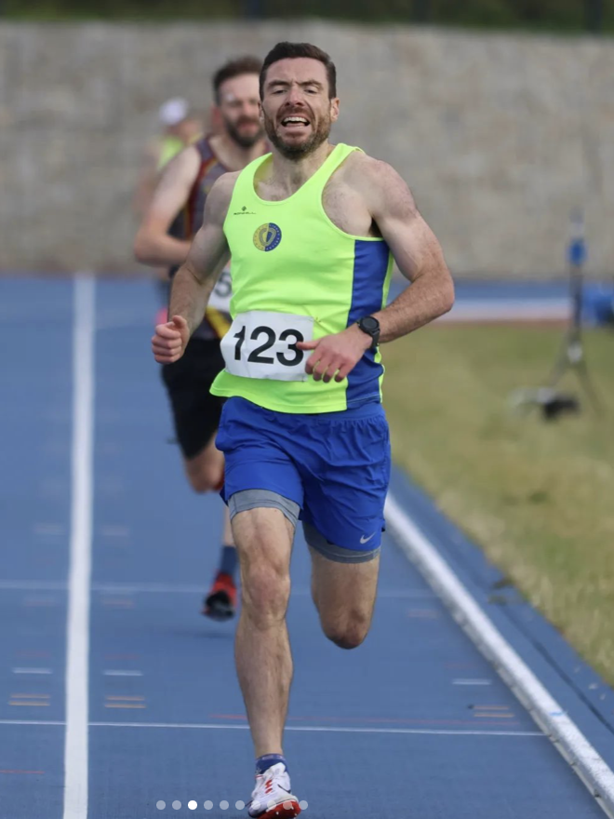
ROAD RACES
2022/2023 Season Review
Notes:
ID=dd91c577-f997-49fe-a5eb-611d59b20eb8 Recipe=crop Type=Foreground Variant=0 FamilyID=ClassicFrameGoudy_Zero

Slide 28
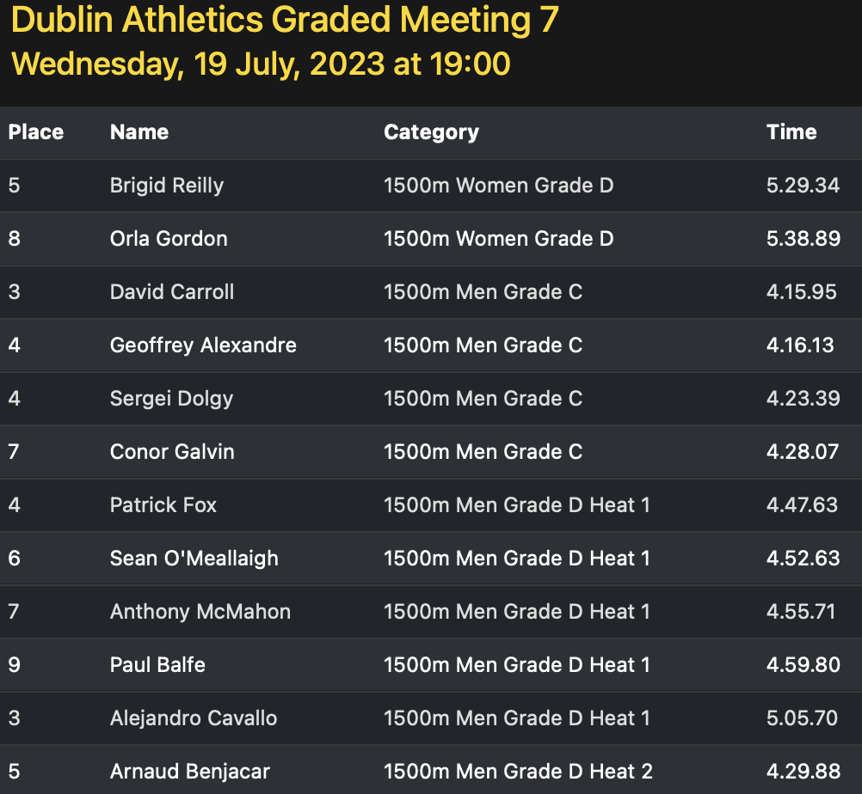
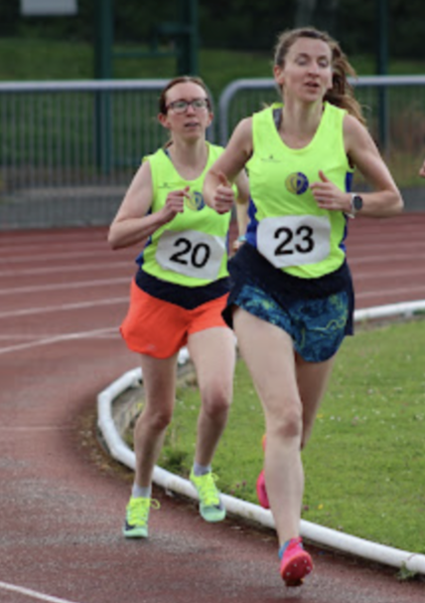
ROAD RACES
2022/2023 Season Review
Notes:
ID=dd91c577-f997-49fe-a5eb-611d59b20eb8 Recipe=crop Type=Foreground Variant=0 FamilyID=ClassicFrameGoudy_Zero

Slide 29
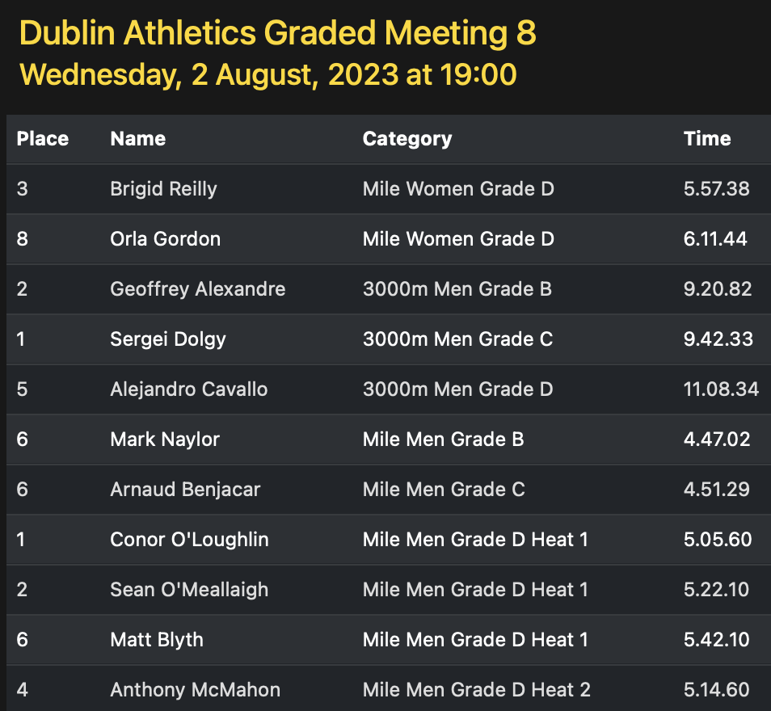
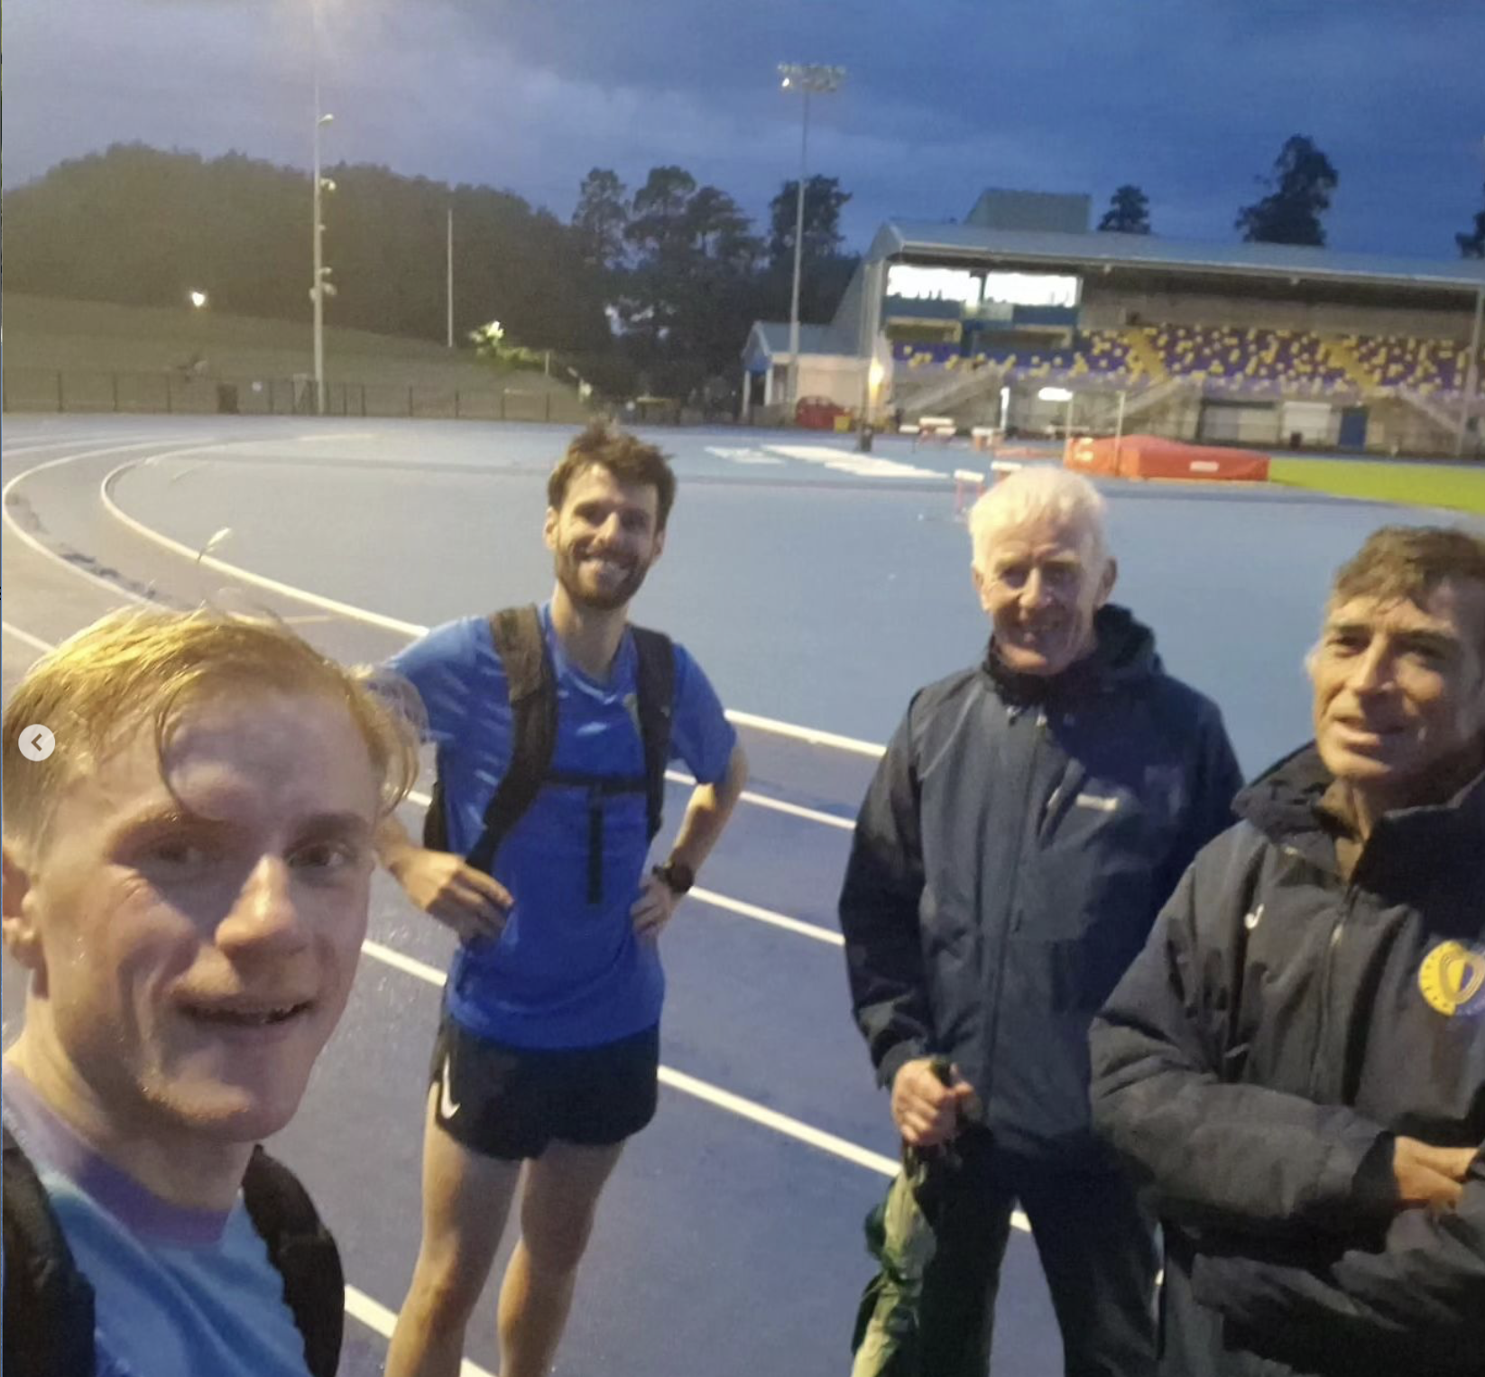
ROAD RACES
2022/2023 Season Review
Notes:
ID=dd91c577-f997-49fe-a5eb-611d59b20eb8 Recipe=crop Type=Foreground Variant=0 FamilyID=ClassicFrameGoudy_Zero

Slide 30
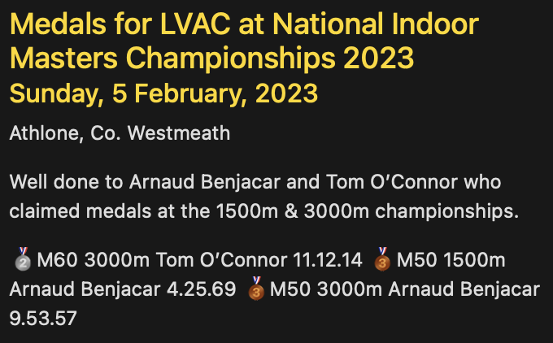
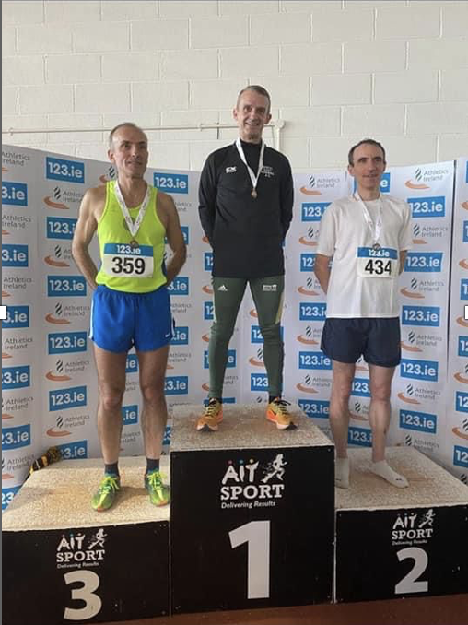
2022/2023 Season Review
Notes:
ID=dd91c577-f997-49fe-a5eb-611d59b20eb8 Recipe=crop Type=Foreground Variant=0 FamilyID=ClassicFrameGoudy_Zero

Slide 31
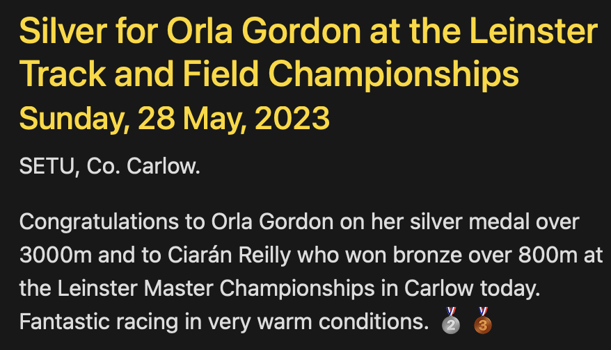
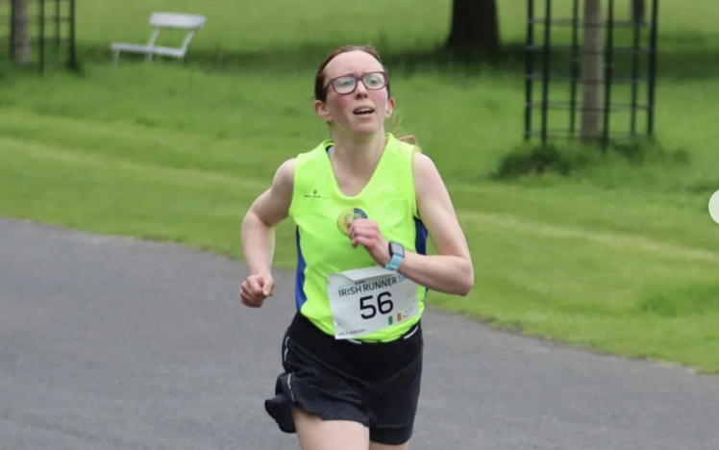
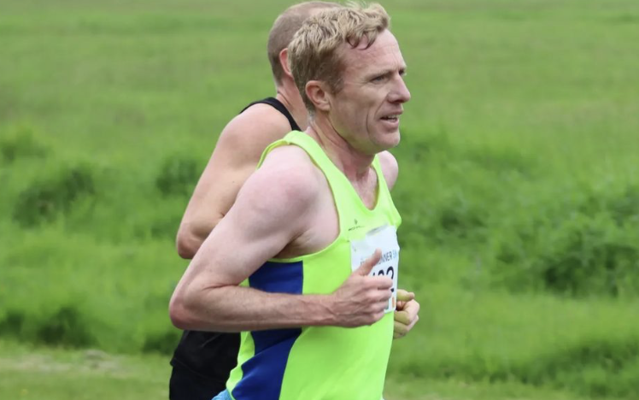
2022/2023 Season Review
Notes:
ID=dd91c577-f997-49fe-a5eb-611d59b20eb8 Recipe=crop Type=Foreground Variant=0 FamilyID=ClassicFrameGoudy_Zero

Slide 32
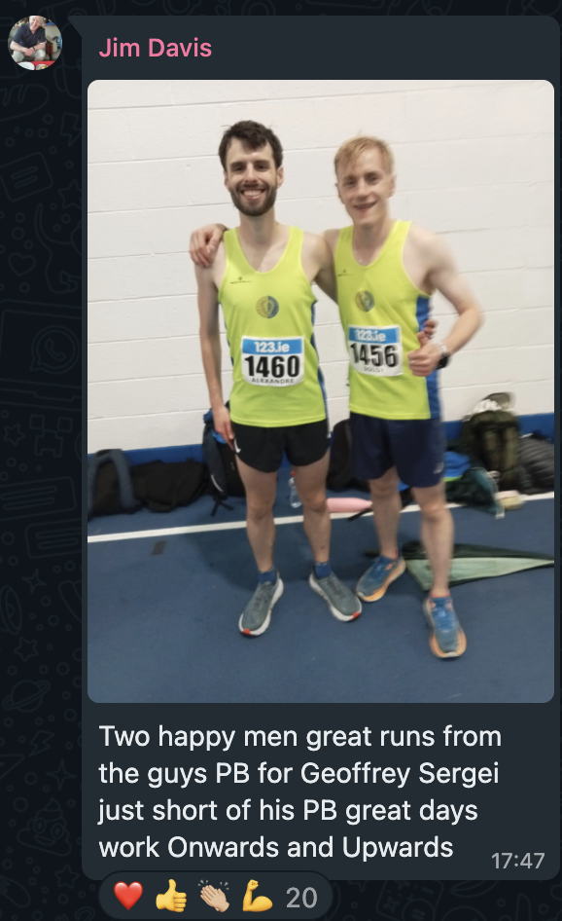
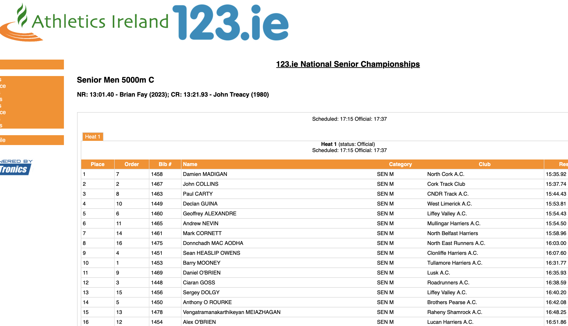
2022/2023 Season Review
Notes:
ID=dd91c577-f997-49fe-a5eb-611d59b20eb8 Recipe=crop Type=Foreground Variant=0 FamilyID=ClassicFrameGoudy_Zero

Slide 33
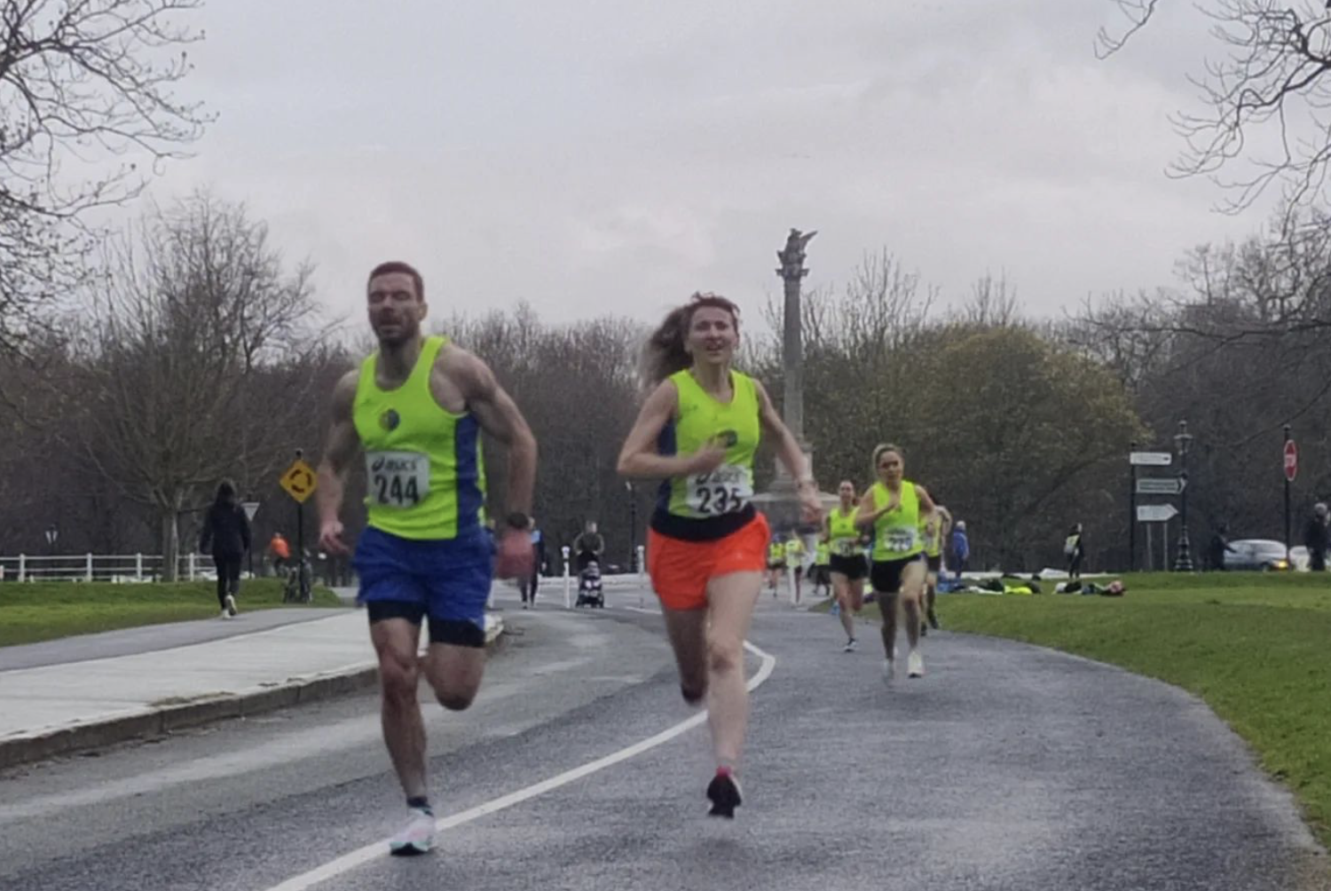
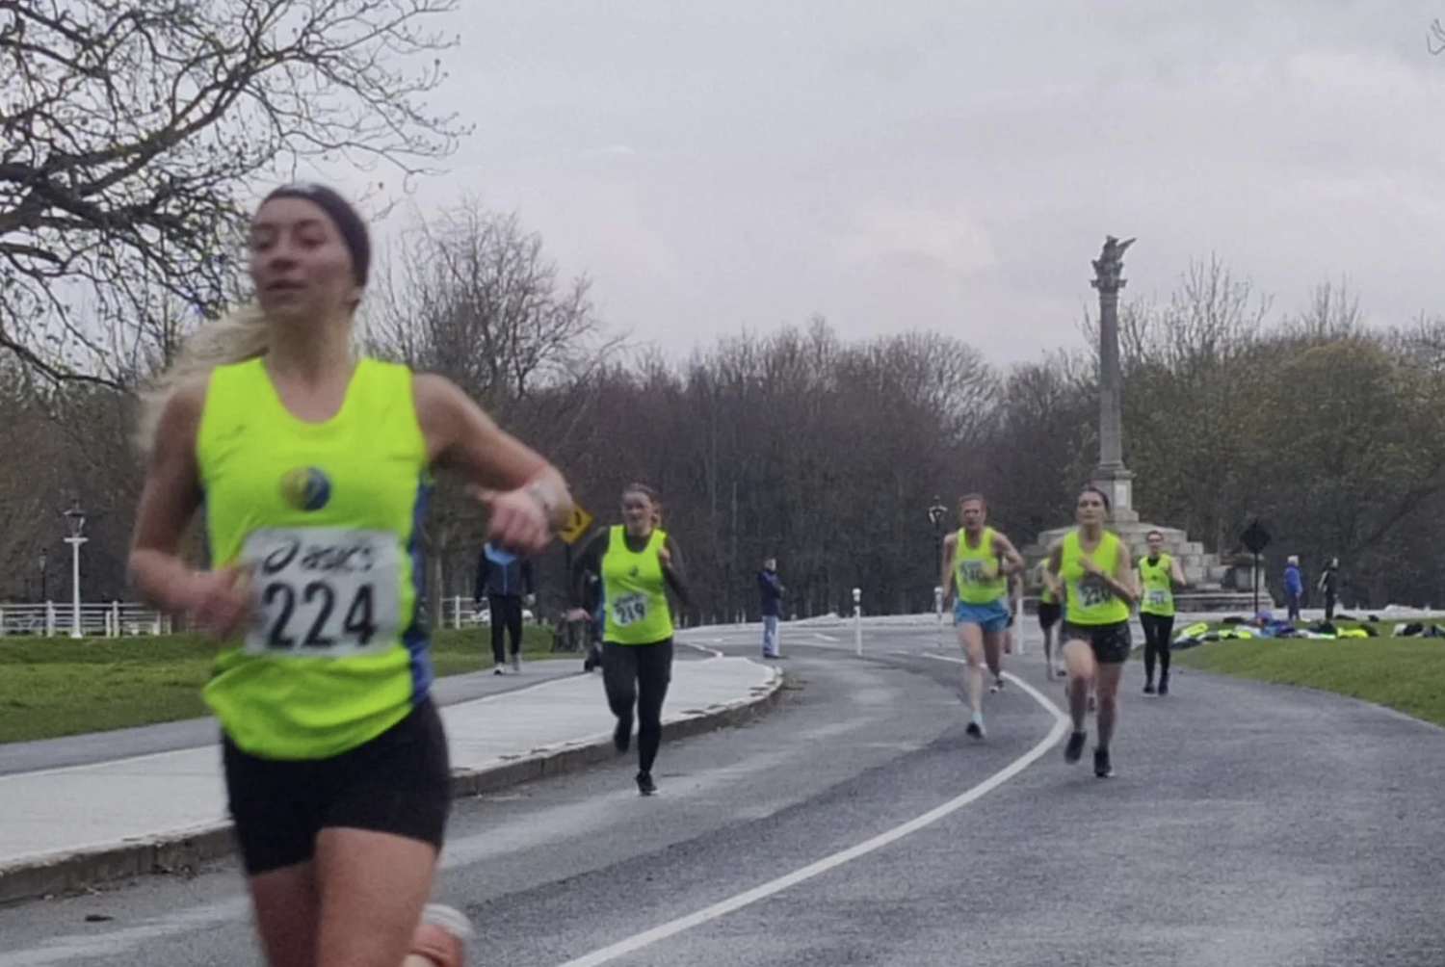
ROAD RACES
2022/2023 Season Review
Notes:
ID=dd91c577-f997-49fe-a5eb-611d59b20eb8 Recipe=crop Type=Foreground Variant=0 FamilyID=ClassicFrameGoudy_Zero

Slide 34

ROAD SUMMARY
49 Athletes took part across 10 championship races
Championship Races
National 6
Leinster 1
Dublin 3
Team Medals 🥇🥈
Individual Medals🥉🥇🥇🥈🥉🥉🥇🥉🥇🥈
10+ Other Club Races participated in
2022/2023 Season Review
Notes:
ID=dd91c577-f997-49fe-a5eb-611d59b20eb8 Recipe=crop Type=Foreground Variant=0 FamilyID=ClassicFrameGoudy_Zero

Slide 35
ROAD RACES
October
Dublin Marathon
April
National 10k
May
National 5k
National 5 mile
June
July
National 10 Mile
September
National Road Relays
Leinster Novice
August
National Half Marathon
LVAC 5k Road
LVAC 10k Road
Dublin Half Marathon
March
LVAC Avondale Cup
Dublin Novice
LVAC 2 Mile

Slide 36
ROAD RACES
5k Road races
Date | Race Name | Athlete | Time
03-Dec | Jingle Bells 5k Race | Peter Arthur | 14.47
03-Dec | Jingle Bells 5k Race | Geoffrey Alexandre | 16.03
03-Dec | Jingle Bells 5k Race | Pierce Geoghegan | 16.52
03-Dec | Jingle Bells 5k Race | Conor Galvin | 17.15
03-Dec | Jingle Bells 5k Race | Keith Lunders | 17.55
03-Dec | Jingle Bells 5k Race | Kevin McDonnell | 18.20
03-Dec | Jingle Bells 5k Race | Matt Blyth | 18.25
03-Dec | Jingle Bells 5k Race | Peter Bowe | 18.57
03-Dec | Jingle Bells 5k Race | Paulius Zeimys | 19.18
20-May | National Road 5k | Pat Collins | 23.31
20-May | National Road 5k | Jen Preston | 18.50
20-May | National Road 5k | Elle O'Driscoll | 18.56
20-May | National Road 5k | Mollie O'Donnell | 19.36
20-May | National Road 5k | Orla Gordon | 20.28
20-May | National Road 5k | Brigid Reilly | 20.43
Date | Race Name | Athlete | Time
20-May | National Road 5k | Rebecca McLoughlin | 22.01
20-May | National Road 5k | Palina Piankova | 22.17
20-May | National Road 5k | Aoife Brady | 23.26
20-May | National Road 5k | Ruth Murphy | 24.09
20-May | National Road 5k | Heather Browning | 26.22
20-May | National Road 5k | Melissa Thompson | 26.23
20-May | National Road 5k | Geoffrey Alexandre | 15.58
20-May | National Road 5k | Mark Naylor | 16.00
20-May | National Road 5k | Sergei Dolgy | 16.14
20-May | National Road 5k | David Carroll | 16.15
29-Jul | Berlin 5km Race | Mark Naylor | 15.59
09-Sep | Dijon 5k | Geoffrey Alexandre | 16.42
09-Sep | Dijon 5k | Sergei Dolgy | 17.26
09-Sep | Dijon 5k | Paul Balfe | 18.53
09-Sep | Dijon 5k | David Mitchell | 20.17
2022/2023 Season Review
Notes:
ID=dd91c577-f997-49fe-a5eb-611d59b20eb8 Recipe=crop Type=Foreground Variant=0 FamilyID=ClassicFrameGoudy_Zero

Slide 37
ROAD RACES
Half marathon
Date | Race Name | Athlete | Time
02-Apr | Berlin Half Marathon | Siobhán Nugent | 1.43.51
26-Aug | National Half Marathon | Pierce Geoghegan | 1.11.49
26-Aug | National Half Marathon | Ciara Broderick Farrell | 1.29.30
26-Aug | National Half Marathon | John Touhy | 1.31.06
09-Sep | Ratoath Half Marathon | Patrick Fox | 1.24.27
09-Sep | Ratoath Half Marathon | Tom O'Connor | 1.29.23
23-Sep | Dublin Half Marathon | Brigid Reilly | 1.31.14
23-Sep | Dublin Half Marathon | Oisín Murphy | 1.25.42
23-Sep | Dublin Half Marathon | David Van Buren | 1.25.58
23-Sep | Dublin Half Marathon | David Mitchell | 1.33.24
23-Sep | Dublin Half Marathon | Siobhán Nugent | 1.41.44
01-Oct | European Masters Half Marathon | Tom O'Connor | 1.28.57
2022/2023 Season Review
Notes:
ID=dd91c577-f997-49fe-a5eb-611d59b20eb8 Recipe=crop Type=Foreground Variant=0 FamilyID=ClassicFrameGoudy_Zero

Slide 38
ROAD RACES
10K road races
Date | Race Name | Athlete | Time
13-Nov | Livorno 10k Run | Mark Naylor | 34.17
30-Apr | 10 KM DE LA GARDE | Arnaud Benjacar | 37.16
30-Apr | West of Ireland Women's Mini Marathon | Rebecca McLoughlin | 46.57
03-Jun | Cork Marathon 10k | David Carroll | 34.52
03-Jun | Cork Marathon 10k | Jen Preston | 39.39
03-Jun | Cork Marathon 10k | Conor Galvin | 38.33
16-Jul | Fingal 10k | Keith Lunders | 38.22
16-Jul | Fingal 10k | Oisín Murphy | 40.13
16-Jul | Fingal 10k | Alejandro Cavallo | 41.28
2022/2023 Season Review
Notes:
ID=dd91c577-f997-49fe-a5eb-611d59b20eb8 Recipe=crop Type=Foreground Variant=0 FamilyID=ClassicFrameGoudy_Zero

Slide 39
ROAD RACES
marathon
Date | Race Name | Athlete | Time
30-Oct | Dublin Marathon | Elle O'Driscoll | 3.16.59
30-Oct | Dublin Marathon | Brigid Reilly | 3.28.04
30-Oct | Dublin Marathon | Michelle Skeath | 4.28.56
30-Oct | Dublin Marathon | Sergei Dolgy | 2.49.49
30-Oct | Dublin Marathon | Simon Monds | 2.54.57
30-Oct | Dublin Marathon | John Touhy | 3.09.00
30-Oct | Dublin Marathon | David Van Buren | 3.11.49
30-Oct | Dublin Marathon | Glen Forde | 3.31.21
30-Oct | Dublin Marathon | Philip Williams | 3.31.21
02-Apr | Paris Marathon | Elle O'Driscoll | 3.04.55
02-Apr | Paris Marathon | Shauna Dunne | 3.38.38
16-Apr | Rotterdam Marathon | Geoffrey Alexandre | 2.50.45
16-Apr | Rotterdam Marathon | Kevin O’Connell | 3.26.19
30-Apr | Great Limerick Run | Conor O’Loughlin | 3.02.19
03-Jun | Cork Marathon | Simon Monds | 2.55.14
03-Jun | Cork Marathon | Ciara Broderick Farrell | 3.08.41
03-Jun | Cork Marathon | Mollie O'Donnell | 3.16.15
03-Jun | Cork Marathon | David Mitchell | 3.38.43
2022/2023 Season Review
Notes:
ID=dd91c577-f997-49fe-a5eb-611d59b20eb8 Recipe=crop Type=Foreground Variant=0 FamilyID=ClassicFrameGoudy_Zero

Slide 40


ROAD RACES
2022/2023 Season Review
Notes:
ID=dd91c577-f997-49fe-a5eb-611d59b20eb8 Recipe=crop Type=Foreground Variant=0 FamilyID=ClassicFrameGoudy_Zero

Slide 41


ROAD RACES
🥉
2022/2023 Season Review
Notes:
ID=dd91c577-f997-49fe-a5eb-611d59b20eb8 Recipe=crop Type=Foreground Variant=0 FamilyID=ClassicFrameGoudy_Zero

Slide 42



ROAD RACES
2022/2023 Season Review
Notes:
ID=dd91c577-f997-49fe-a5eb-611d59b20eb8 Recipe=crop Type=Foreground Variant=0 FamilyID=ClassicFrameGoudy_Zero

Slide 43


ROAD RACES
2022/2023 Season Review
Notes:
ID=dd91c577-f997-49fe-a5eb-611d59b20eb8 Recipe=crop Type=Foreground Variant=0 FamilyID=ClassicFrameGoudy_Zero

Slide 44



ROAD RACES
2022/2023 Season Review
Notes:
ID=dd91c577-f997-49fe-a5eb-611d59b20eb8 Recipe=crop Type=Foreground Variant=0 FamilyID=ClassicFrameGoudy_Zero

Slide 45


ROAD RACES
2022/2023 Season Review
Notes:
ID=dd91c577-f997-49fe-a5eb-611d59b20eb8 Recipe=crop Type=Foreground Variant=0 FamilyID=ClassicFrameGoudy_Zero

Slide 46




2022/2023 Season Review
Notes:
ID=dd91c577-f997-49fe-a5eb-611d59b20eb8 Recipe=crop Type=Foreground Variant=0 FamilyID=ClassicFrameGoudy_Zero

Slide 47




ROAD RACES
2022/2023 Season Review
Notes:
ID=dd91c577-f997-49fe-a5eb-611d59b20eb8 Recipe=crop Type=Foreground Variant=0 FamilyID=ClassicFrameGoudy_Zero

Slide 48



ROAD RACES
2022/2023 Season Review
Notes:
ID=dd91c577-f997-49fe-a5eb-611d59b20eb8 Recipe=crop Type=Foreground Variant=0 FamilyID=ClassicFrameGoudy_Zero

Slide 49


2022/2023 Season Review
Notes:
ID=dd91c577-f997-49fe-a5eb-611d59b20eb8 Recipe=crop Type=Foreground Variant=0 FamilyID=ClassicFrameGoudy_Zero

Slide 50


ROAD RACES
2022/2023 Season Review
Notes:
ID=dd91c577-f997-49fe-a5eb-611d59b20eb8 Recipe=crop Type=Foreground Variant=0 FamilyID=ClassicFrameGoudy_Zero

Slide 51


ROAD RACES
2022/2023 Season Review
Notes:
ID=dd91c577-f997-49fe-a5eb-611d59b20eb8 Recipe=crop Type=Foreground Variant=0 FamilyID=ClassicFrameGoudy_Zero

Slide 52


ROAD RACES
2022/2023 Season Review
Notes:
ID=dd91c577-f997-49fe-a5eb-611d59b20eb8 Recipe=crop Type=Foreground Variant=0 FamilyID=ClassicFrameGoudy_Zero

Slide 53

ROAD RACES
CLUB CHAMPIONSHIPS
2022/2023 Season Review
Notes:
ID=dd91c577-f997-49fe-a5eb-611d59b20eb8 Recipe=crop Type=Foreground Variant=0 FamilyID=ClassicFrameGoudy_Zero

Slide 54

To Our race day volunteers
Measuring the Course
Marking the Course
Transporting the Tent
Putting up the Tent
Taking Times
Recording Times
Publicizing Races
Working out race handicaps
Taking Photos / Videos
Posting Photos / Videos
Making the Tea/Coffee/Sandwiches/Cakes
…the list goes on…
🙏 Thank you 🙏
2022/2023 Season Review

Slide 55







CLUB CHAMPIONSHIPS
 | Cross Country February 19th 2023 | 800m Track June 28th 2023 | 1500m / 3000m Track July 12th 2023 | 5k / 10k Road September 17th 2023
Women | 🥇 Mollie O'Donnell 🥈 Rebecca McLaughlin 🥉 Brigid Reilly | 🥇 Mollie O'Donnell 🥈 Jen Preston 🥉 Brigid Reilly | 🥇 Mollie O’Donnell 🥈 Brigid Reilly 🥉 Orla Gordon | 🥇 Brianna McGhee 🥈 Brigid Reilly 🥉 Siobhán Nugent
Men | 🥇 David Carroll 🥈 Geoffrey Alexandre 🥉 Sergei Dolgy | 🥇 David Carroll 🥈 Sergei Dolgy 🥉 Geoffrey Alexandre | 🥇 Geoffrey Alexandre 🥈 Pierce Geoghegan 🥉 Mark Naylor | 🥇 Pierce Geoghegan 🥈 Geoffrey Alexandre 🥉 Sergei Dolgy
2022/2023 Season Review

Slide 56




CLUB TROPHIES
Avondale Cup | Winter League | George Harrison Cup | Myles Cullen Cup
🥇 Patrick Fox 🥈 Hilary McDonnell 🥉 Seán O'Meallaigh | 🥇 David Carroll 🥈 Patrick Fox 🥉 Arnaud Benjacar | 🥇 Siobhán Nugent & Heather Browning 🥈 Rebecca McLoughlin 🥉 Annie Gittens | 🥇 Conal Fagan 🥈 Cormac Long 🥉 Sergie Dolgy
2022/2023 Season Review

Slide 57


RACE Results & REPORTS:
https://liffeyvalleyac.com/races/
2022/2023 Season Review

